Slide 1

An NSS Audio-Visual
Library Presentation
The Best of the 1989
NSS Photo Salon
National Speleological Society
S910 70 Slides 2/19/2021

Slide 2
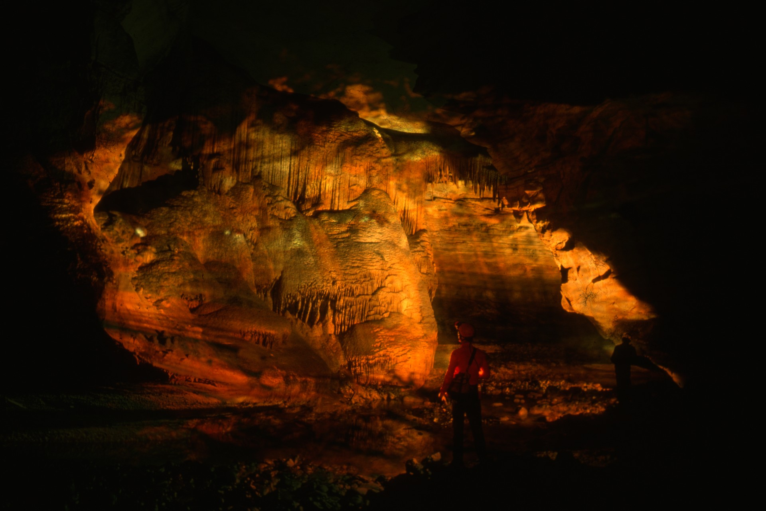
Notes:
BLUFF RIVER REVISITED – Jim Loftin

Slide 3
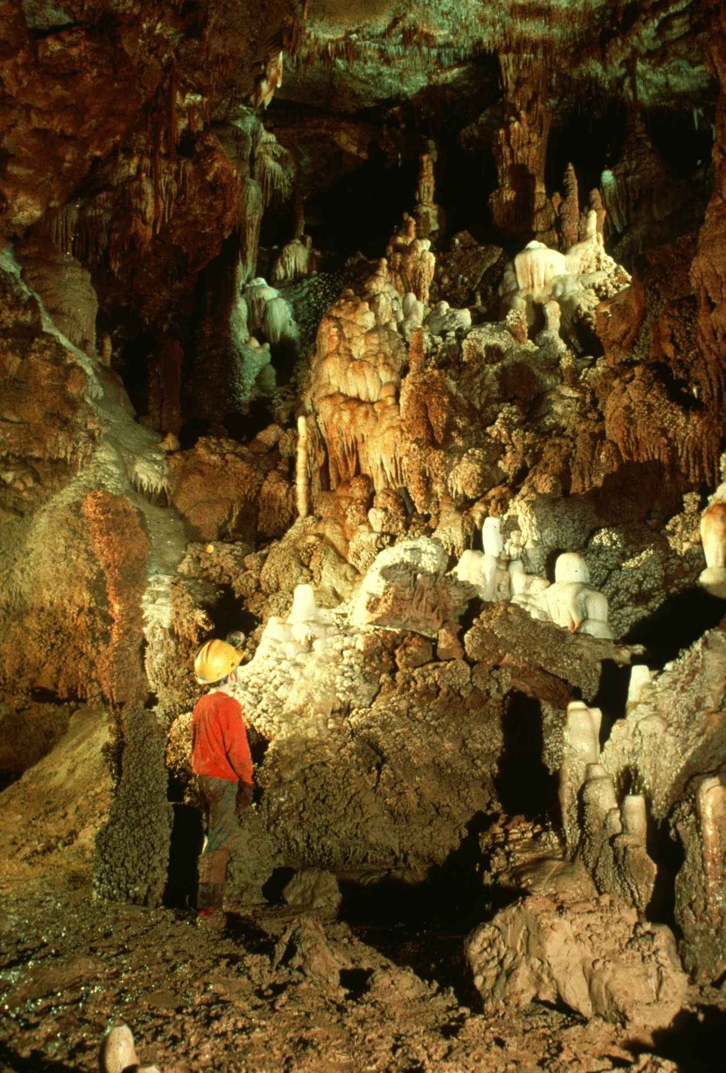
Notes:
THE ARKANSAS CHAMBER – Rick Day

Slide 4
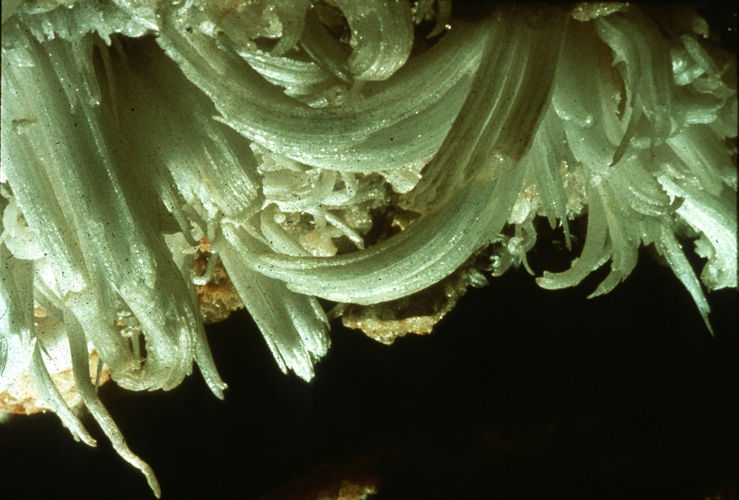
Notes:
FLOWER OF THE NIGHT – Bill Franz

Slide 5
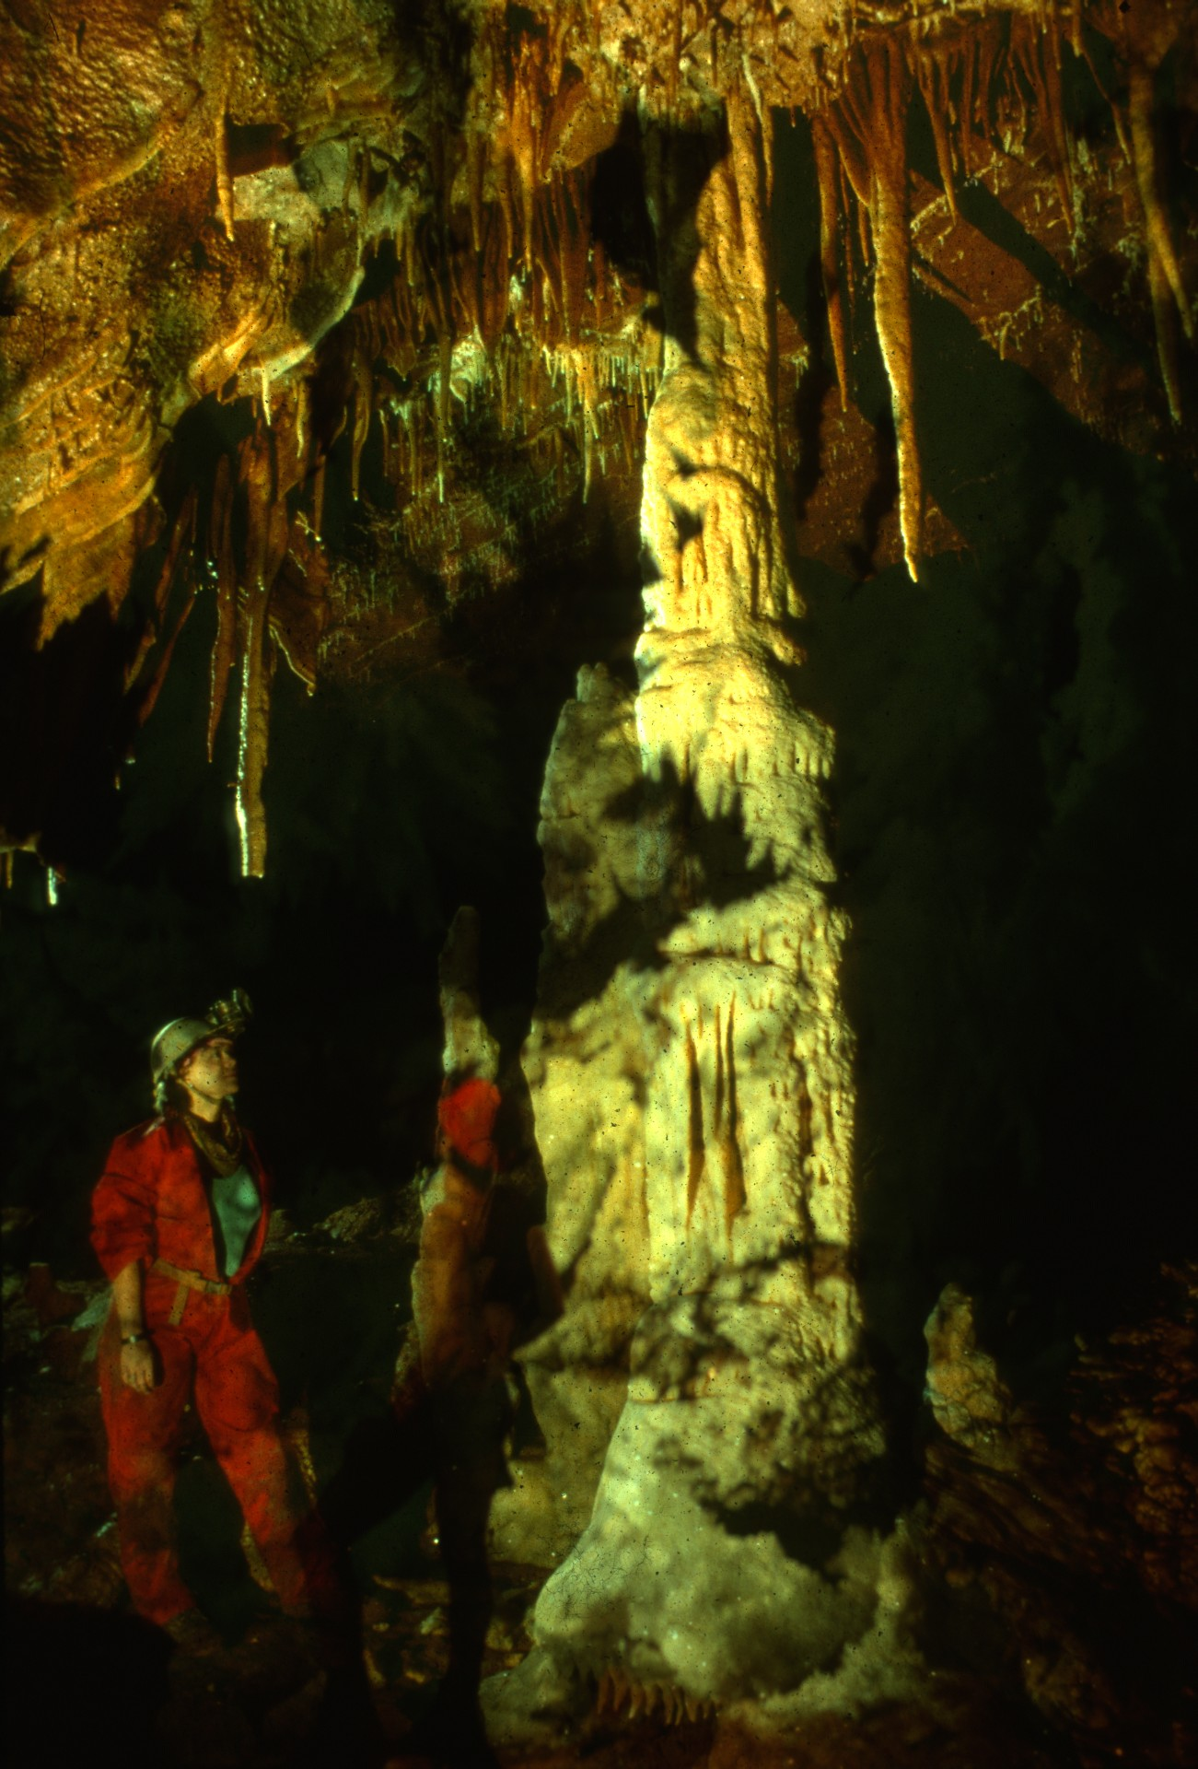
Notes:
TS TOWERS – Rick Day

Slide 6
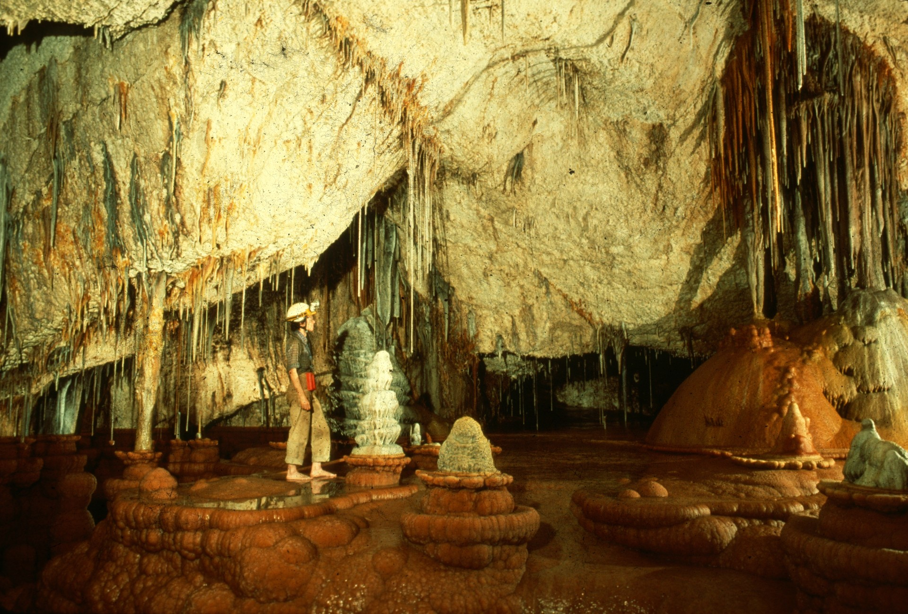
Notes:
JUST A TYPICAL CAVER IN A TYPICAL CAVE – Carol Vesely

Slide 7
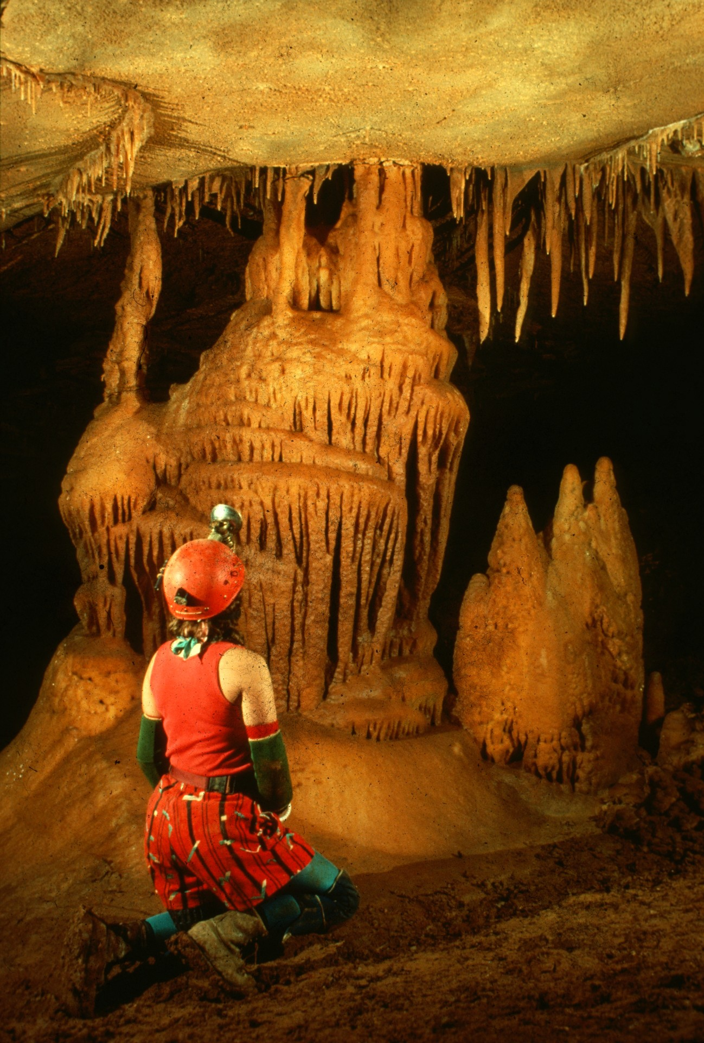
Notes:
ORANGE MESA – Dave Bunnell

Slide 8
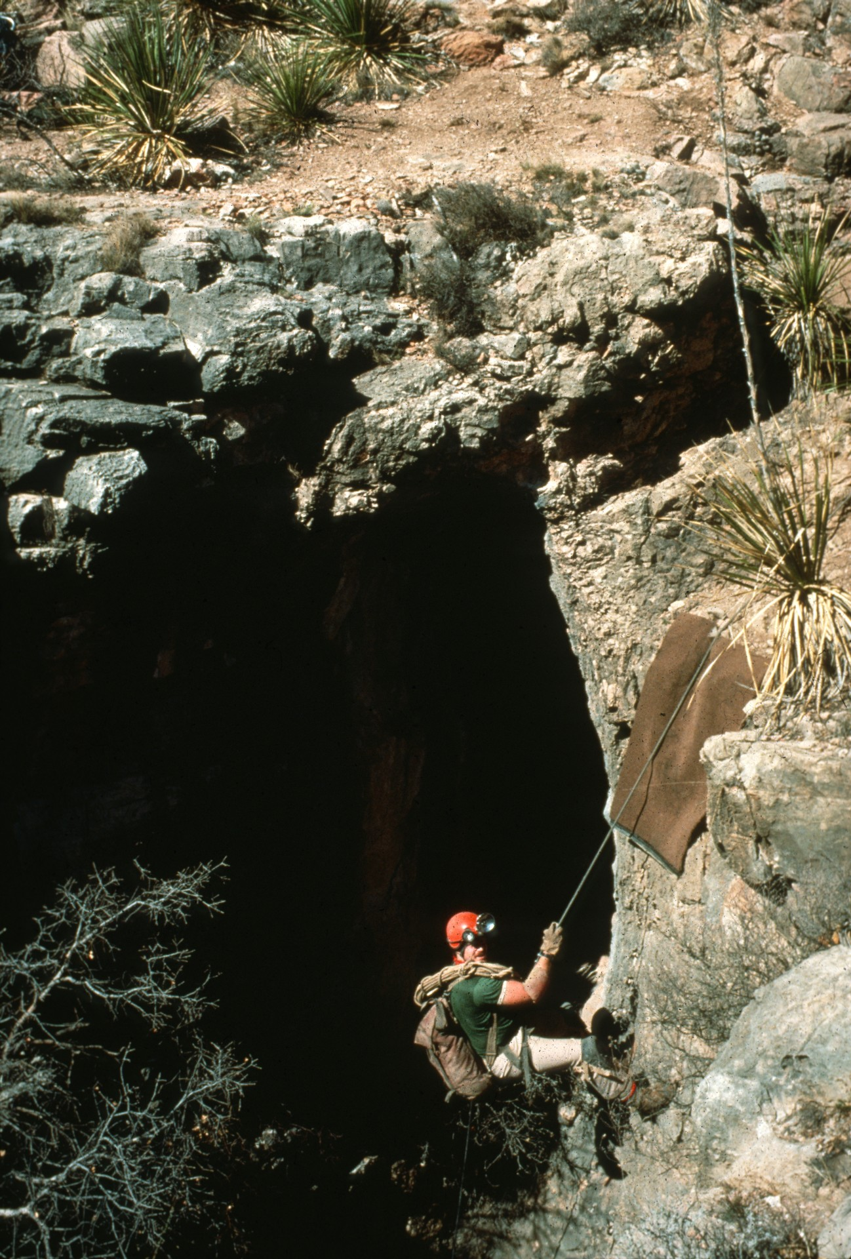
Notes:
INTO THE DEPTHS OF LECHUGUILLA – Ralph Earlandson

Slide 9
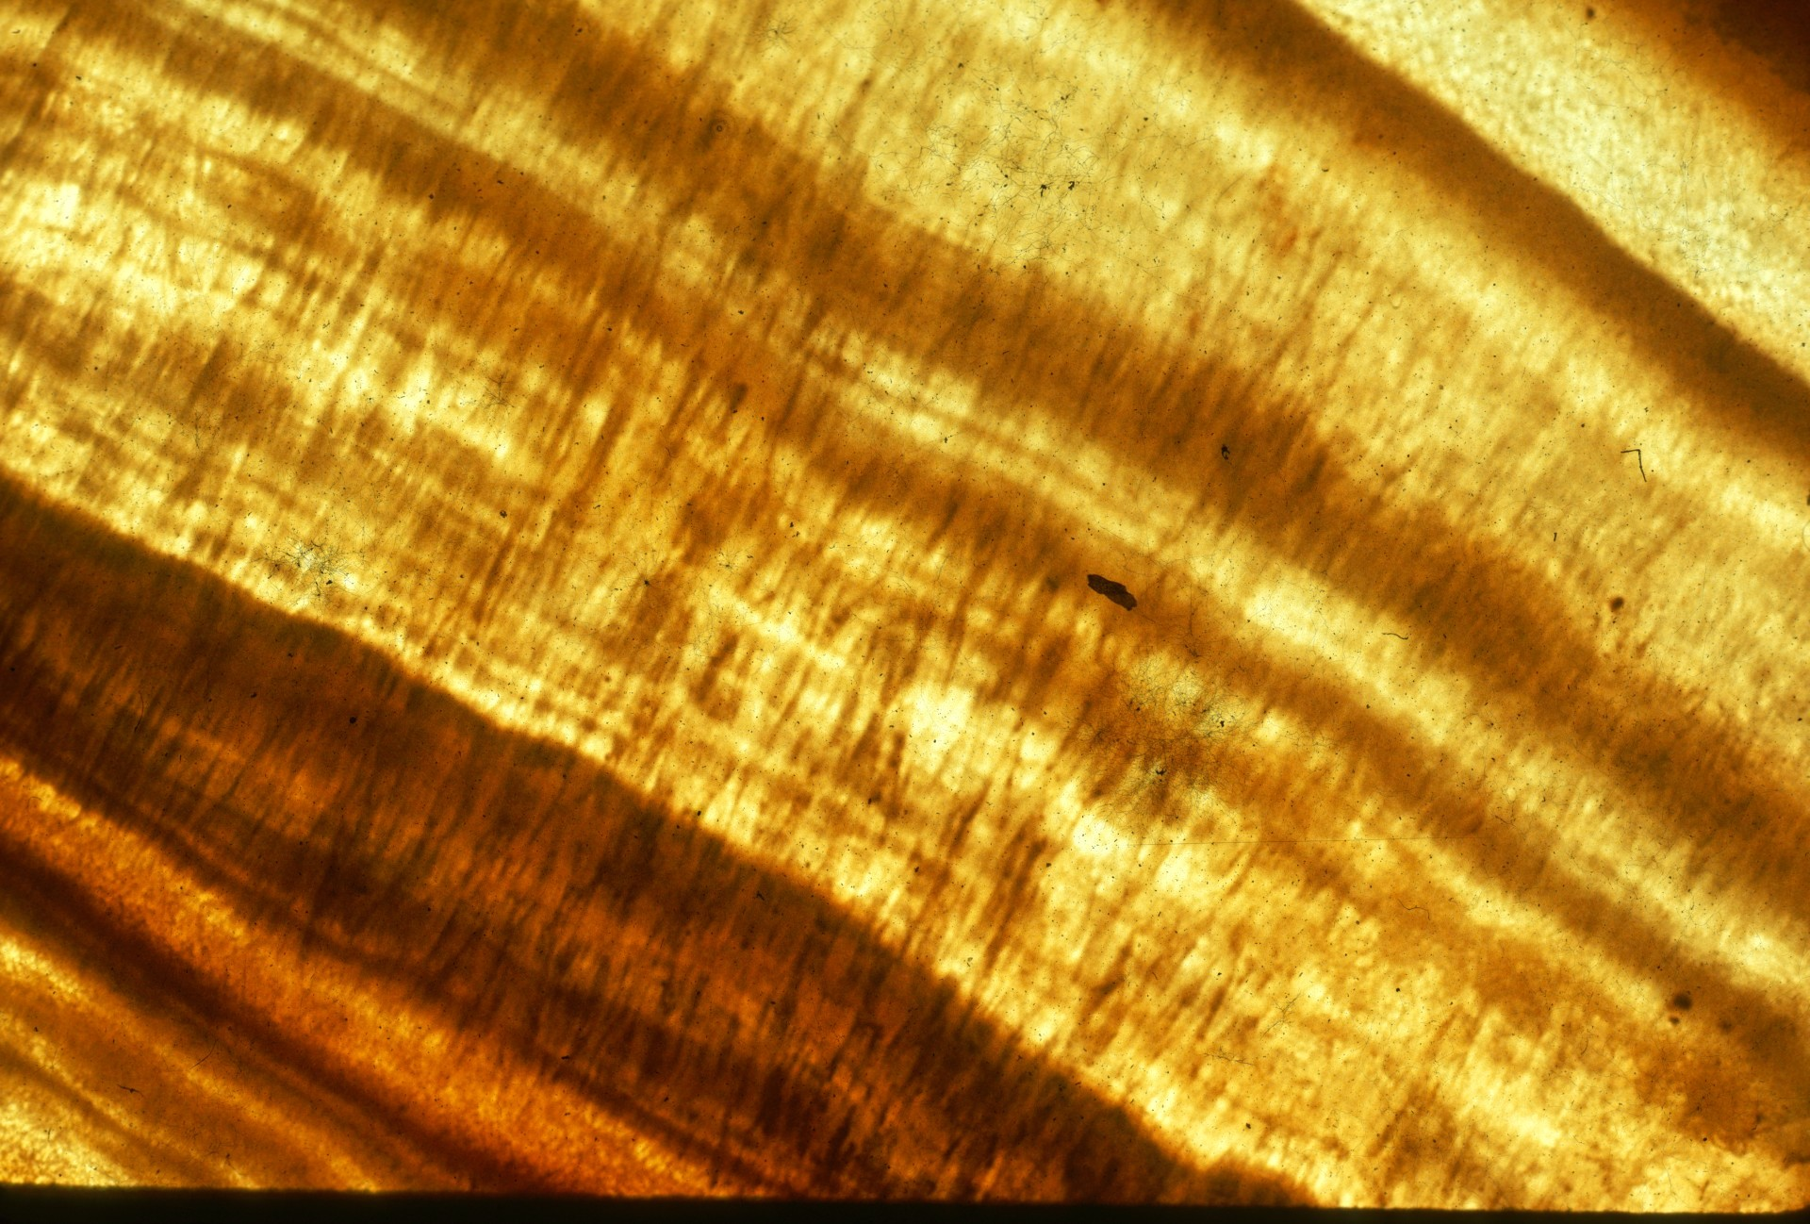
Notes:
BACON – Bill Franz

Slide 10
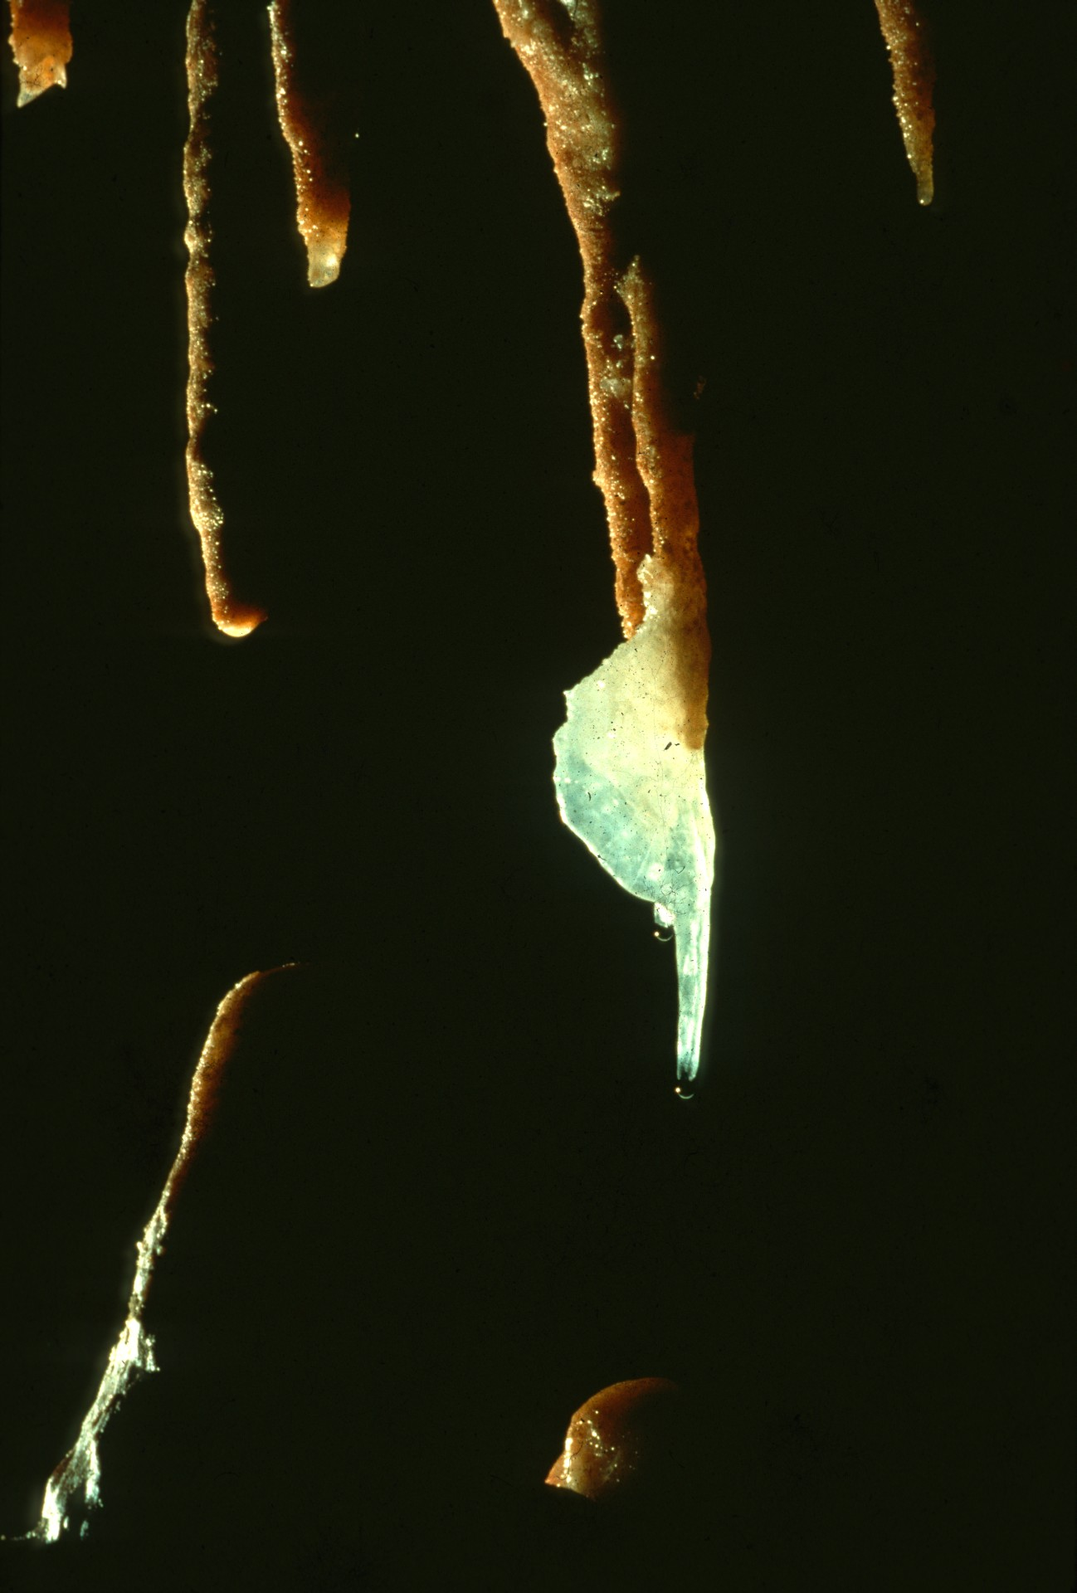
Notes:
LONE BUTTERFLY – Rick Day

Slide 11
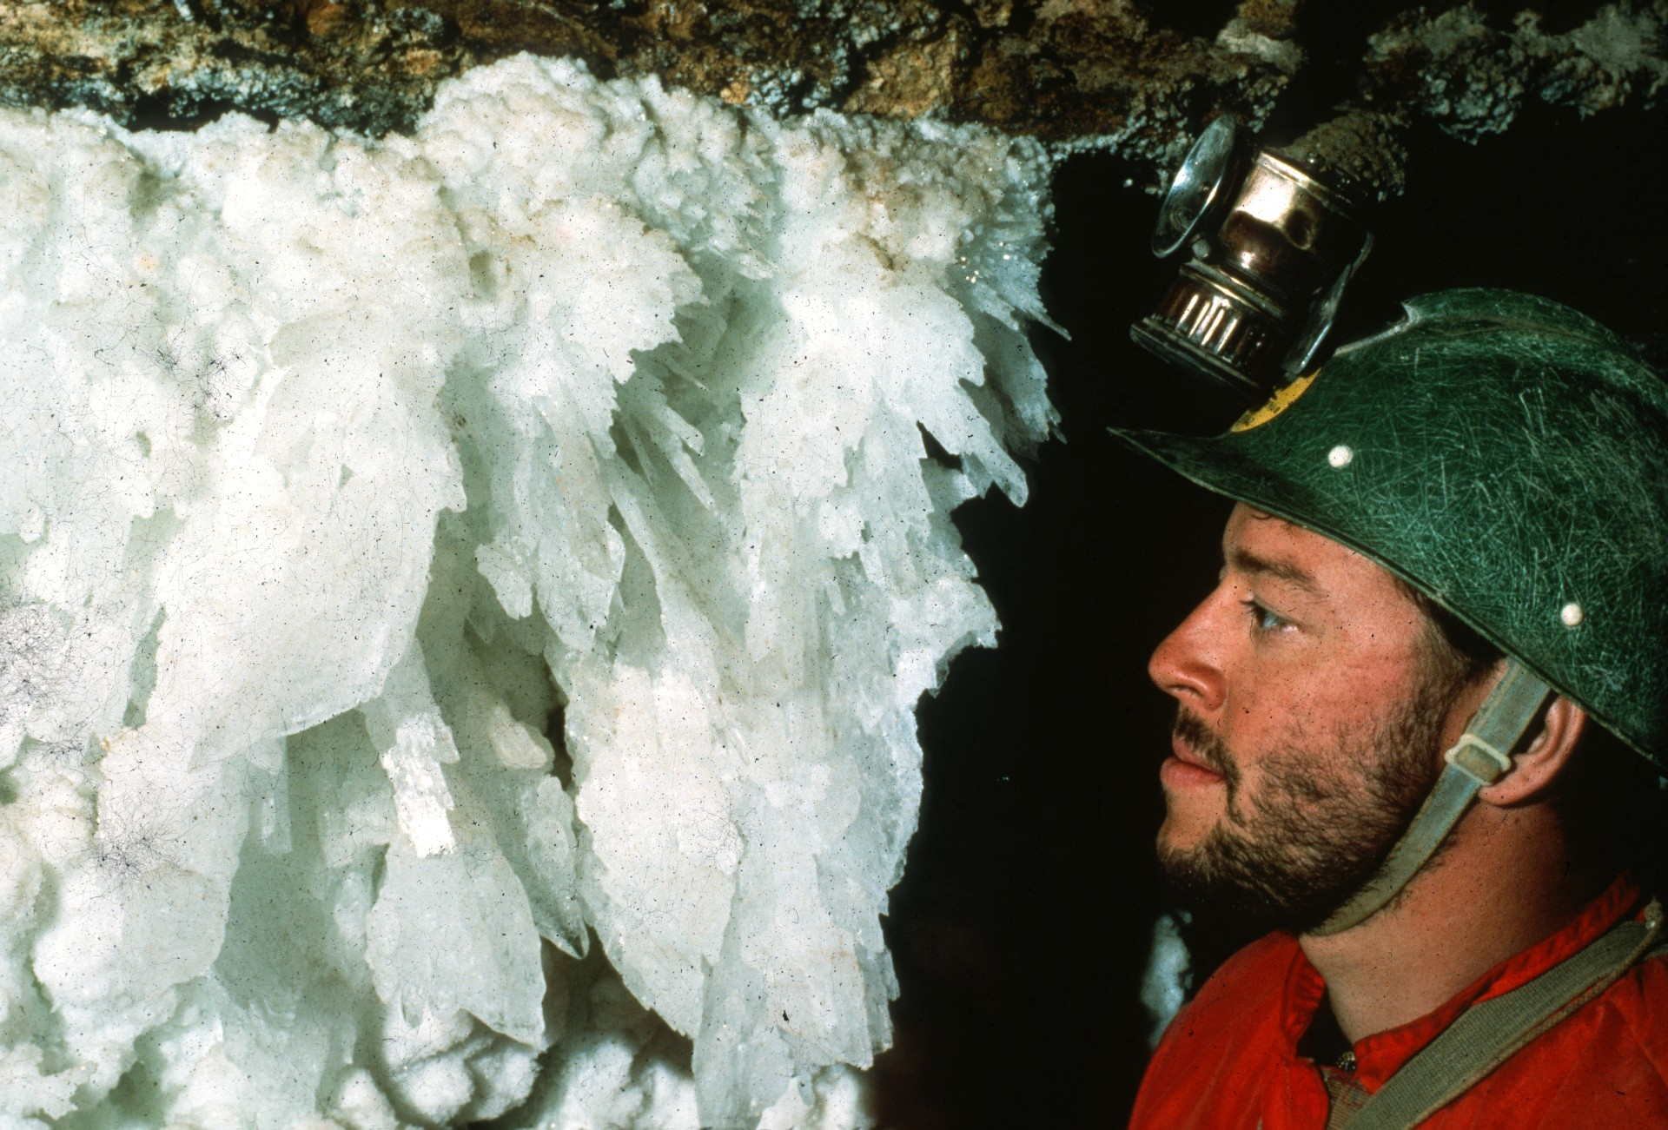
Notes:
FACE TO FACE WITH THE ICE KING – Scott Fee

Slide 12
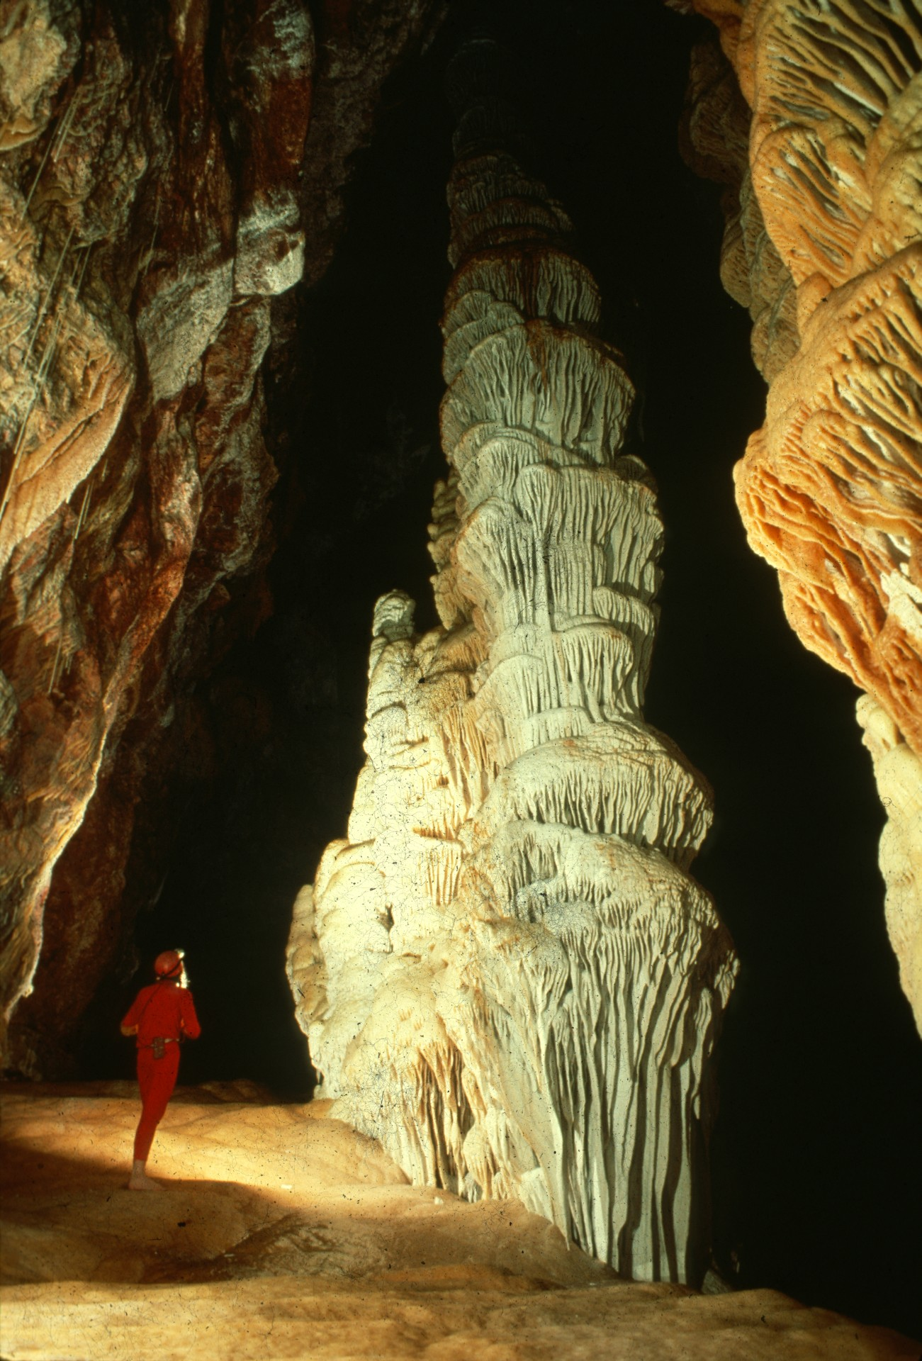
Notes:
TOWER PLACE – Ralph Earlandson

Slide 13
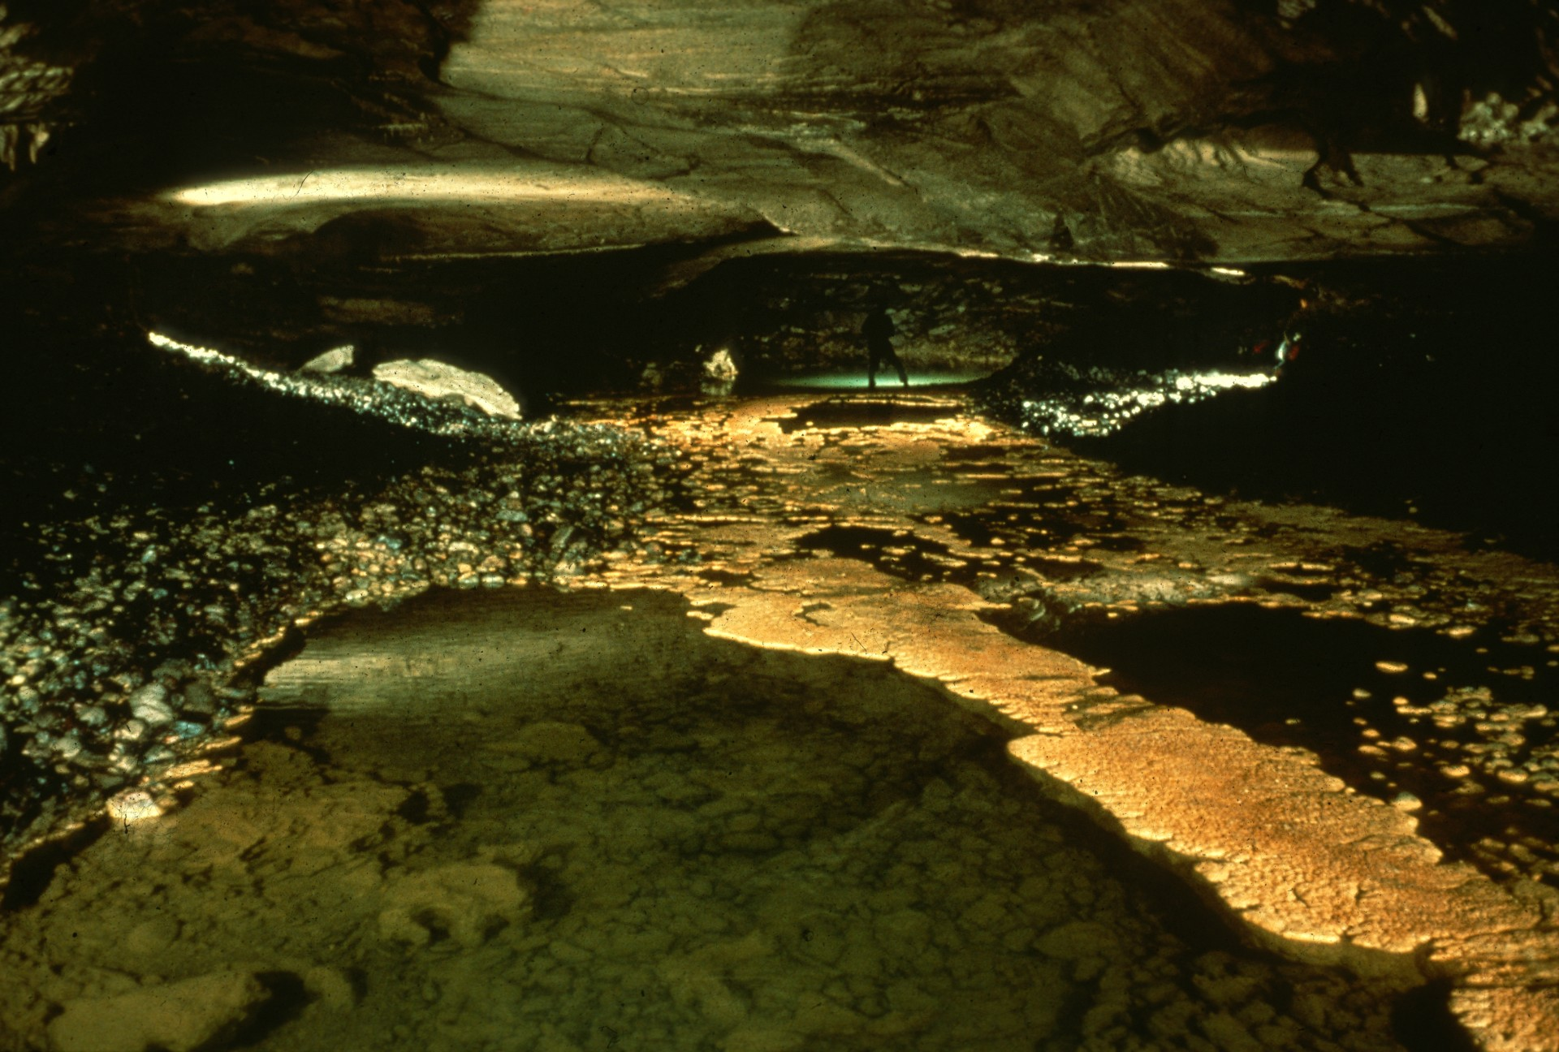
Notes:
PROMENADE IN TURQUOISE – John Van Swearingen IV

Slide 14
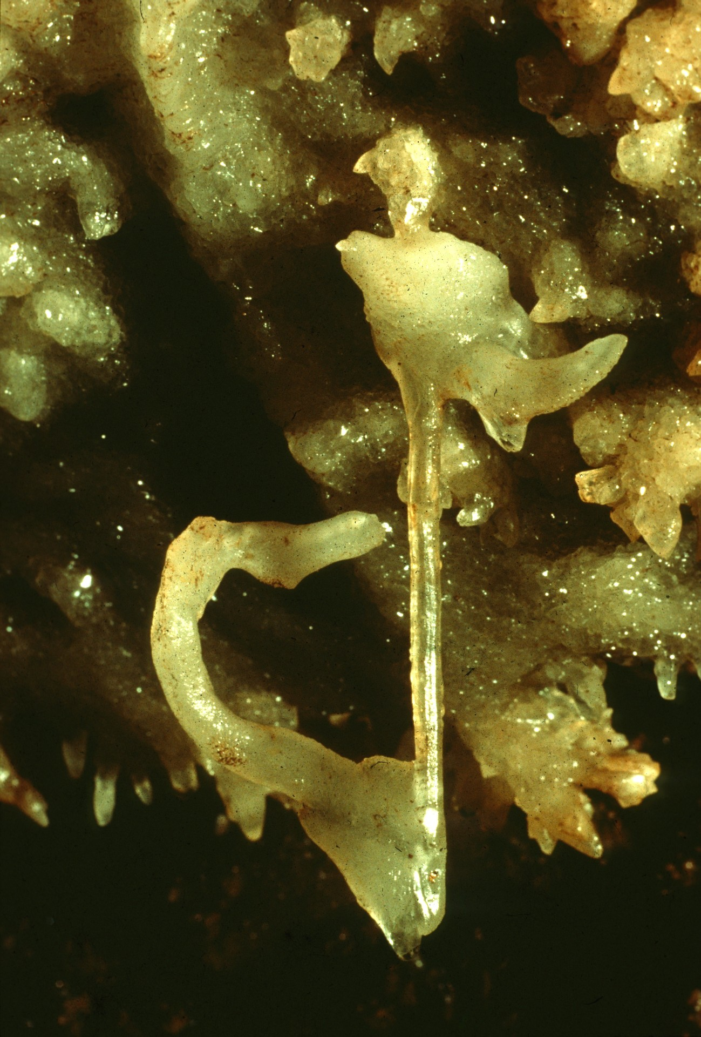
Notes:
ARKANSAS BEAUTY – Ralph Earlandson

Slide 15
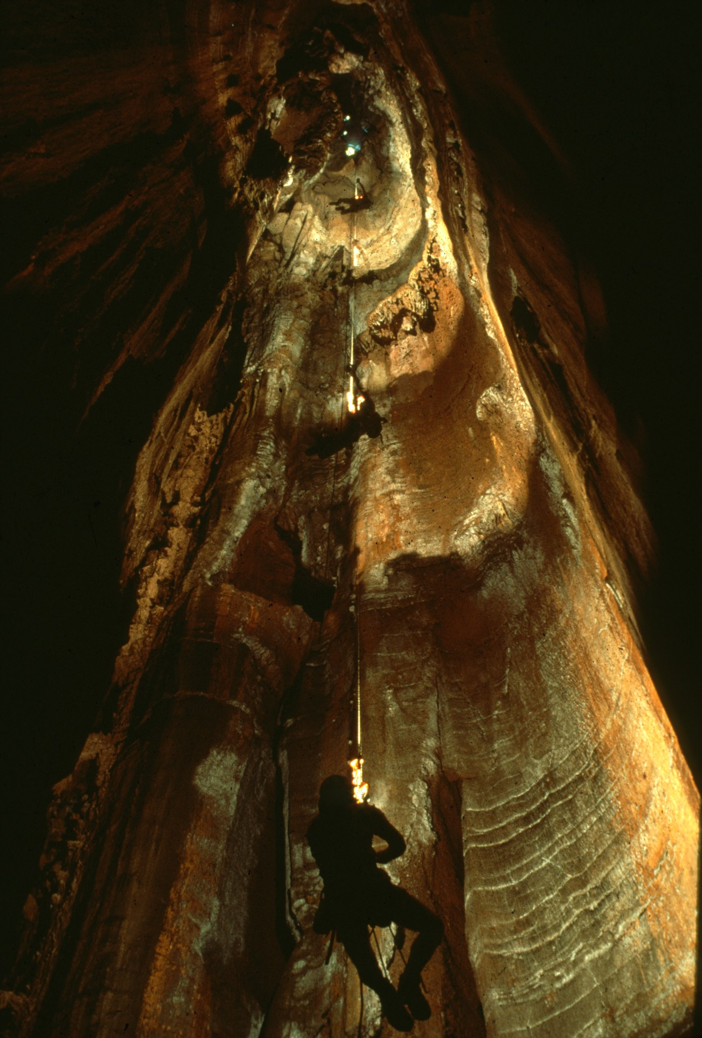
Notes:
PEARSON’S PIT, GEORGIA – Jim Loftin

Slide 16
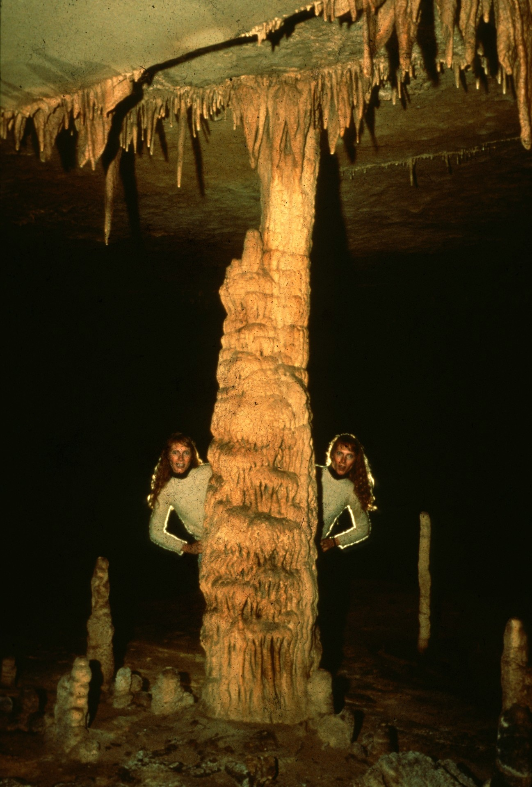
Notes:
LYNN BESIDE HERSELF – John Van Swearingen IV

Slide 17
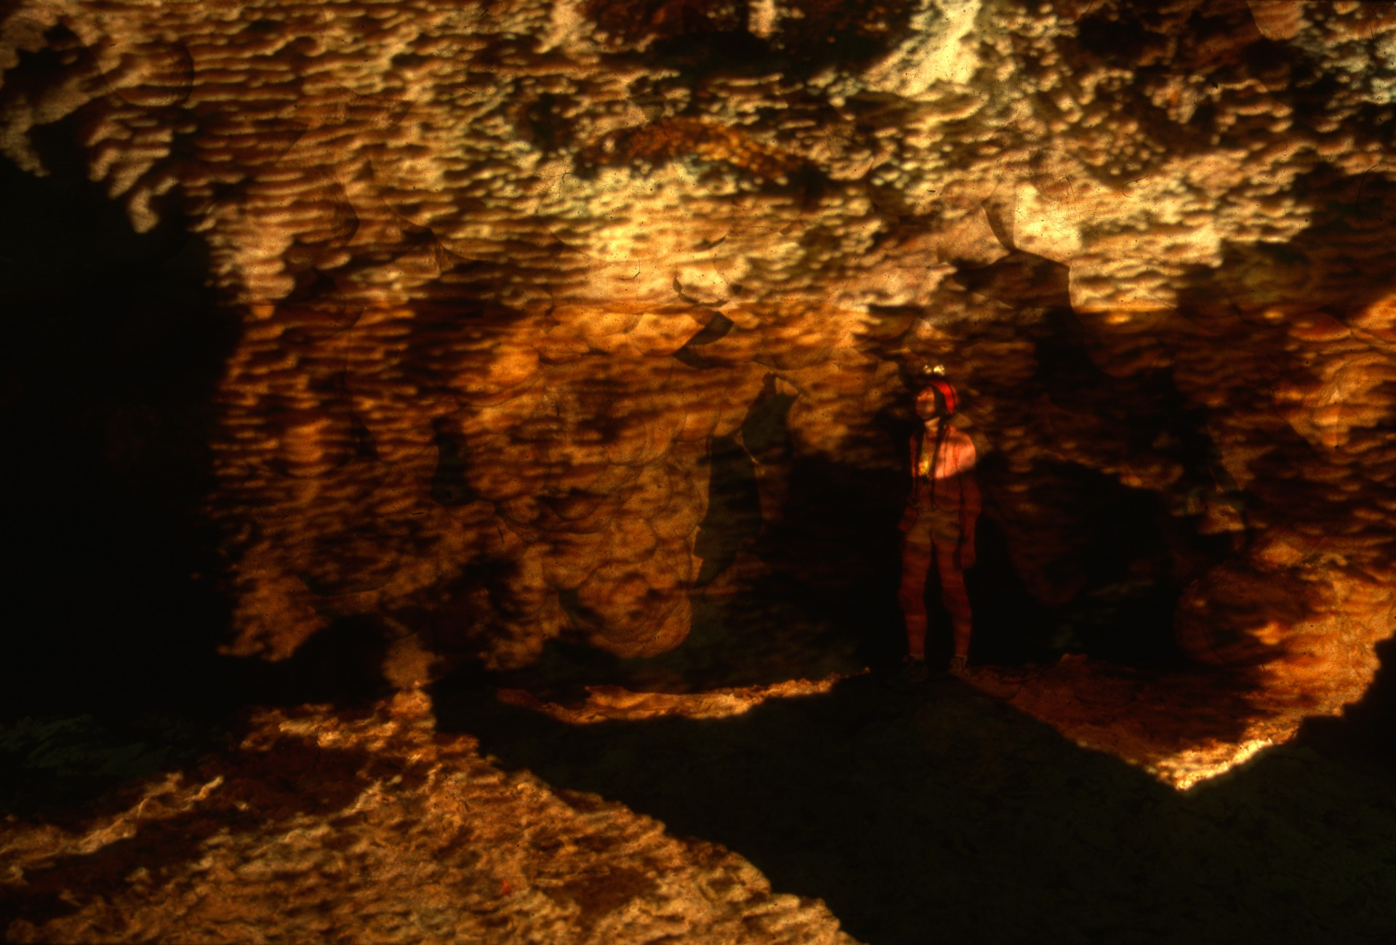
Notes:
WHERE THE LAKE SUBSIDED – Peter & Ann Bosted

Slide 18
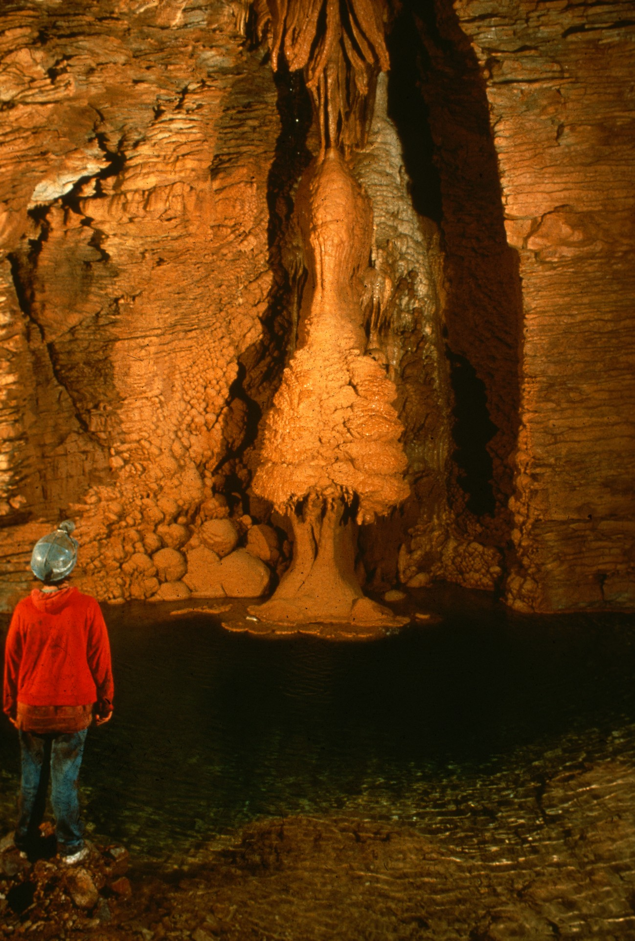
Notes:
BUTTERSCOTCH DELIGHT – Carol Vesely

Slide 19
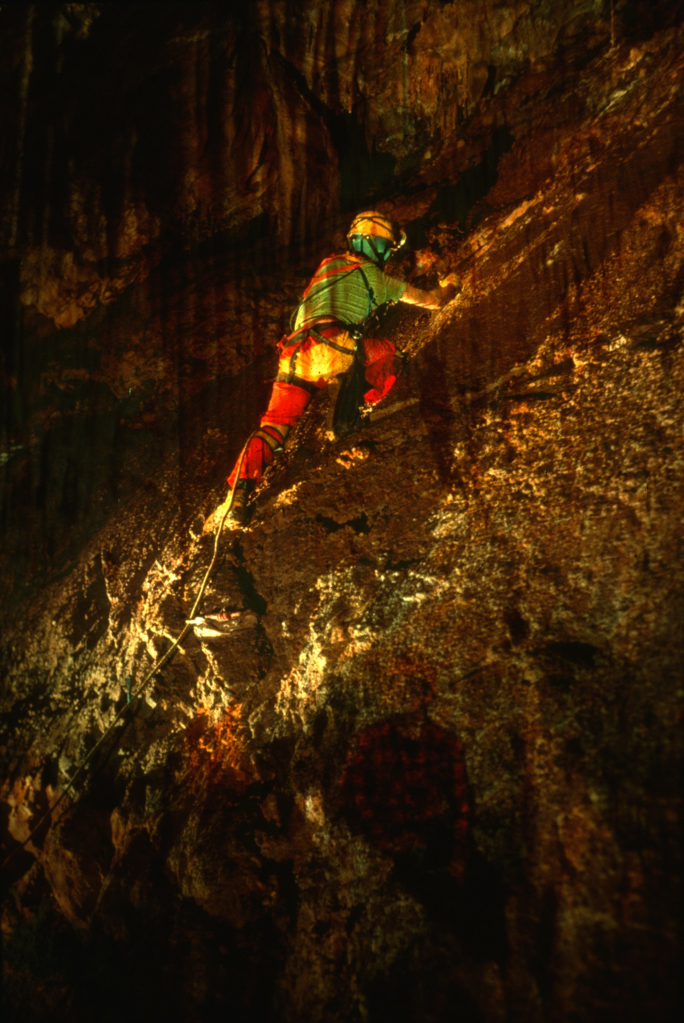
Notes:
THE BOLT CLIMB – Carol Vesely

Slide 20
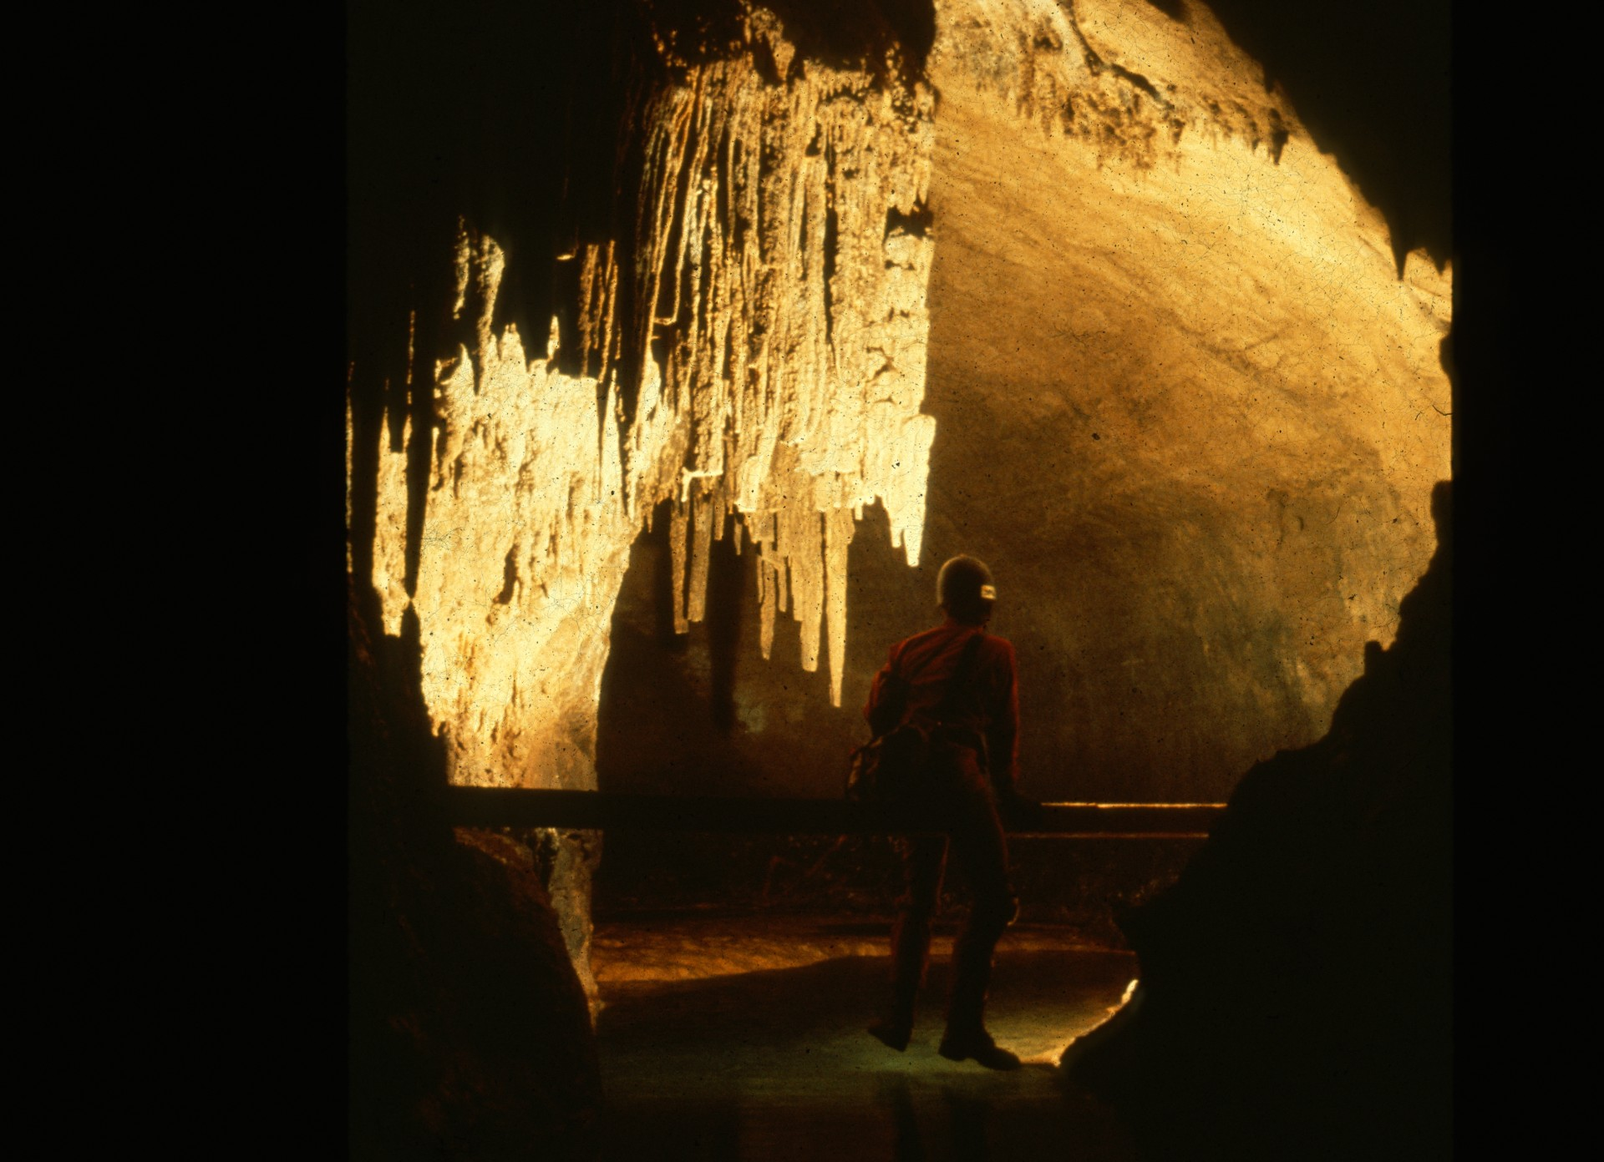
Notes:
LA PUENTE’S CROSSING – Maureen Handler

Slide 21
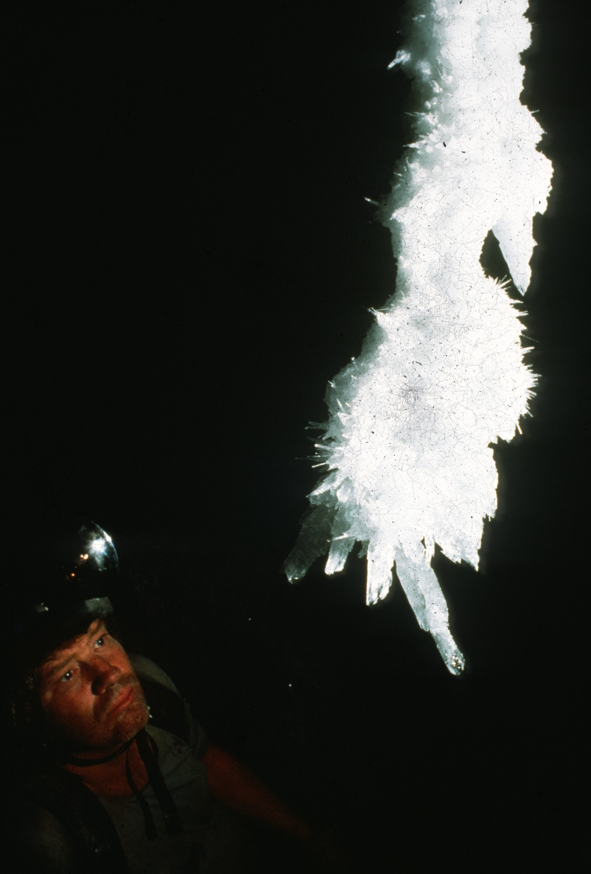
Notes:
TIP OF THE CHANDELIER – Ralph Earlandson

Slide 22
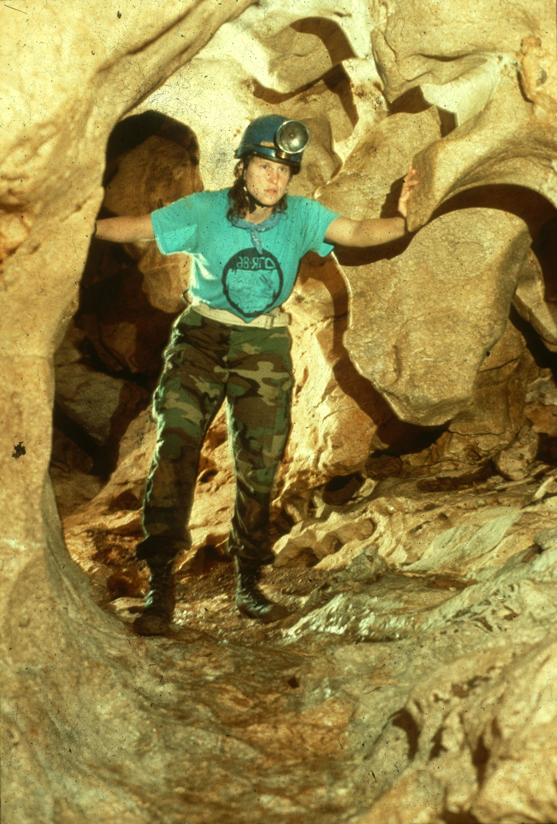
Notes:
ESPERANZA – Scott Fee

Slide 23
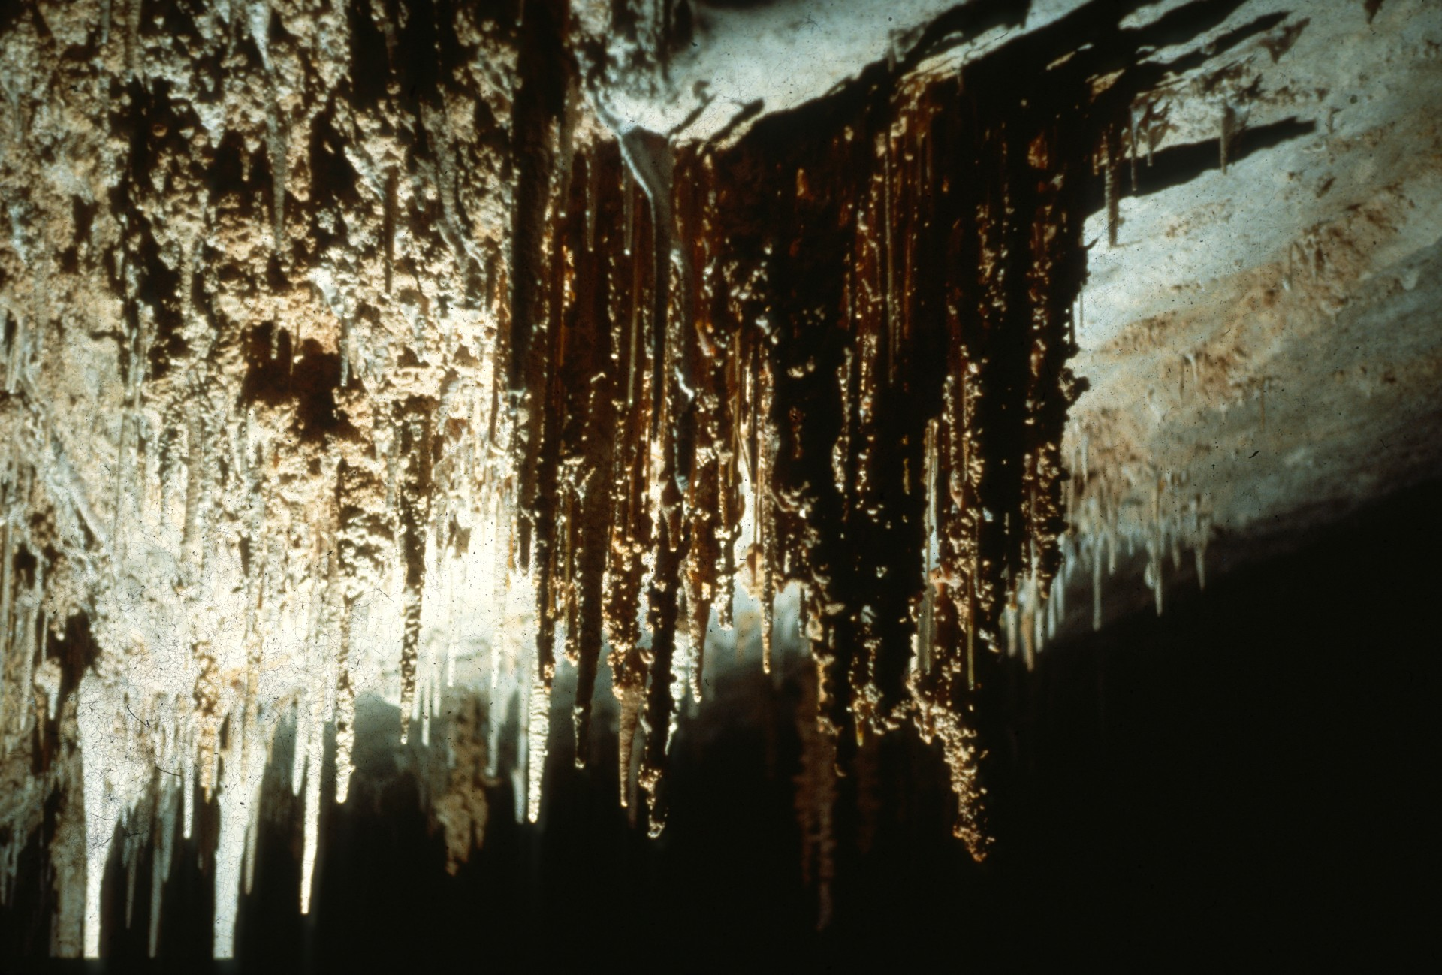
Notes:
STAR CASTLES – Patrick Newby

Slide 24
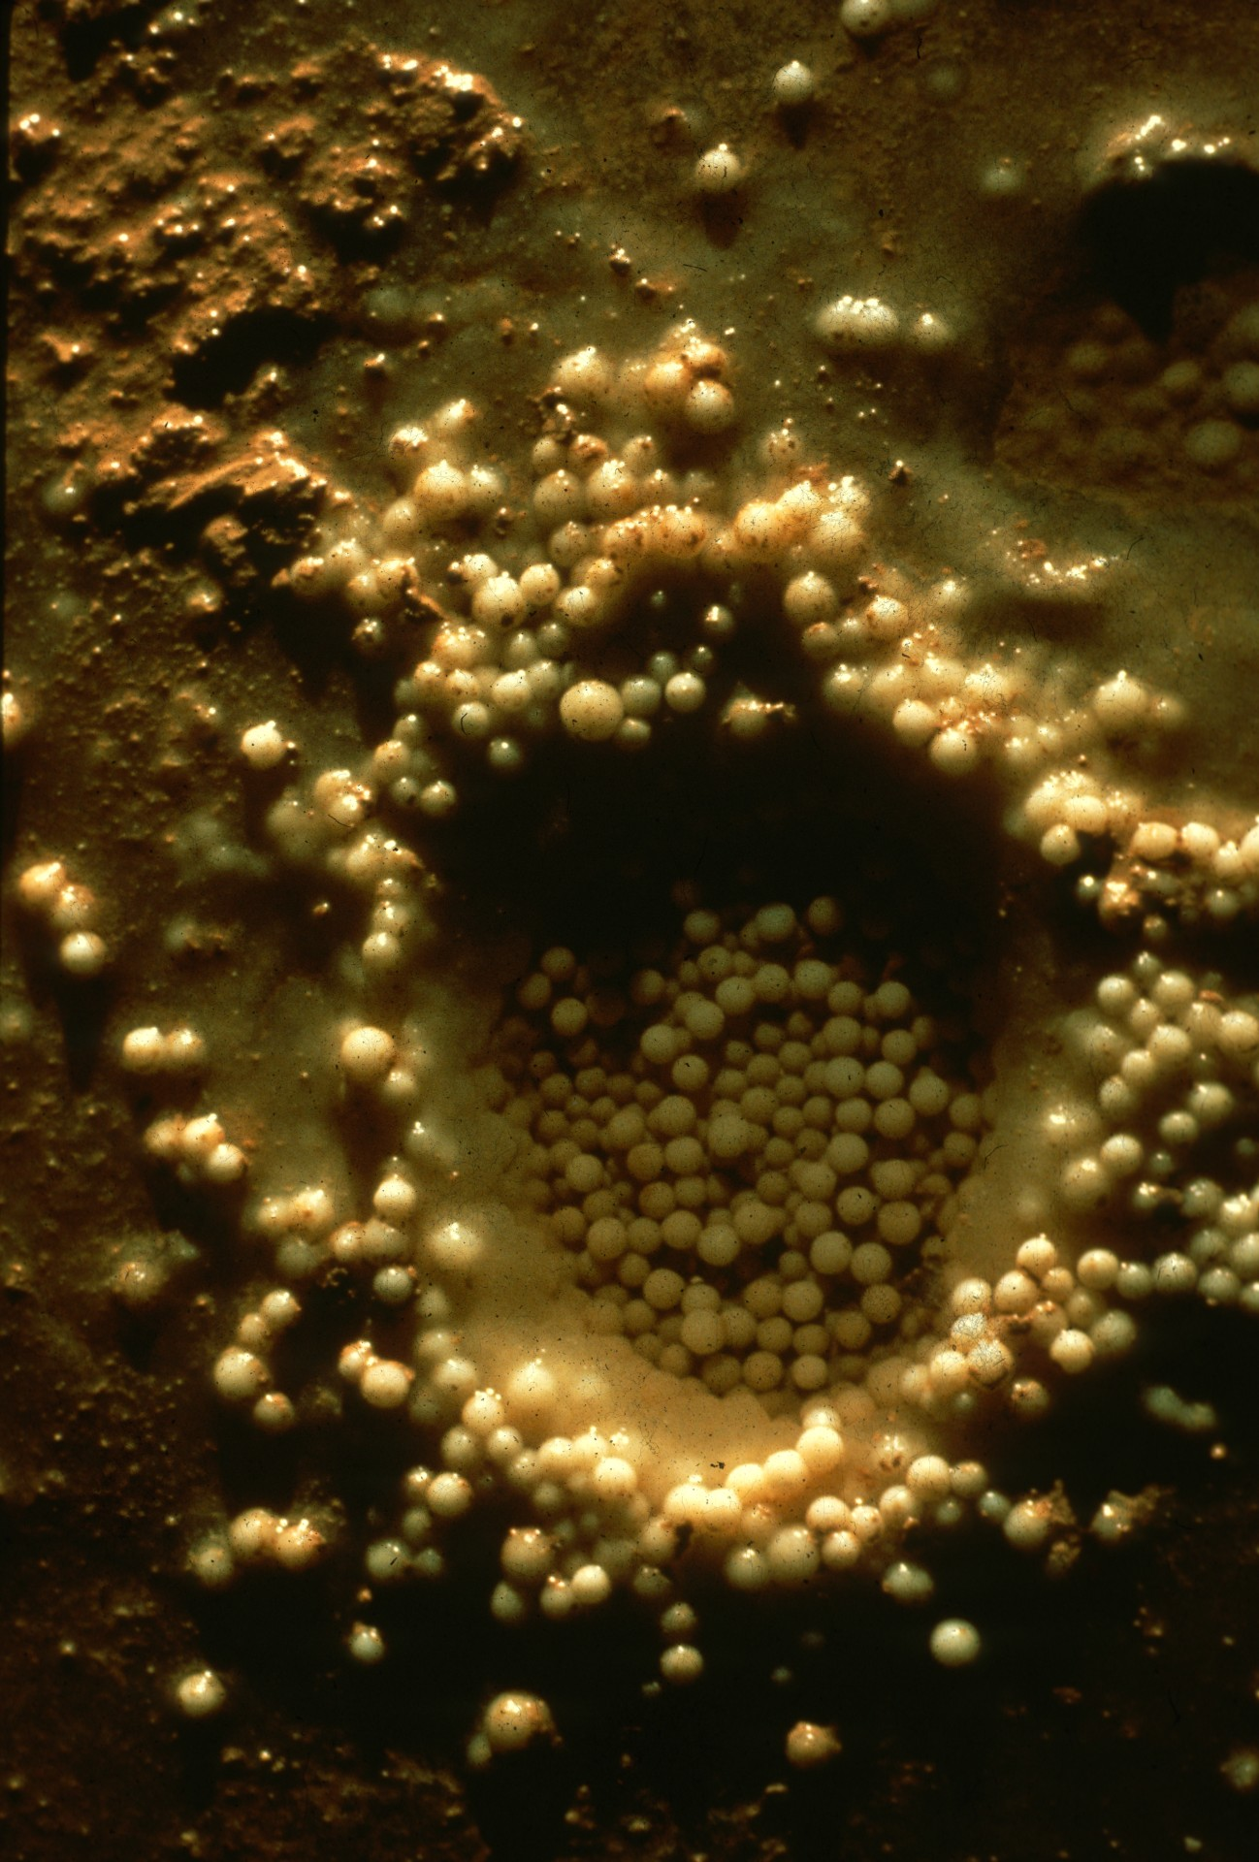
Notes:
NEST OF PEARLS – Ralph Earlandson

Slide 25
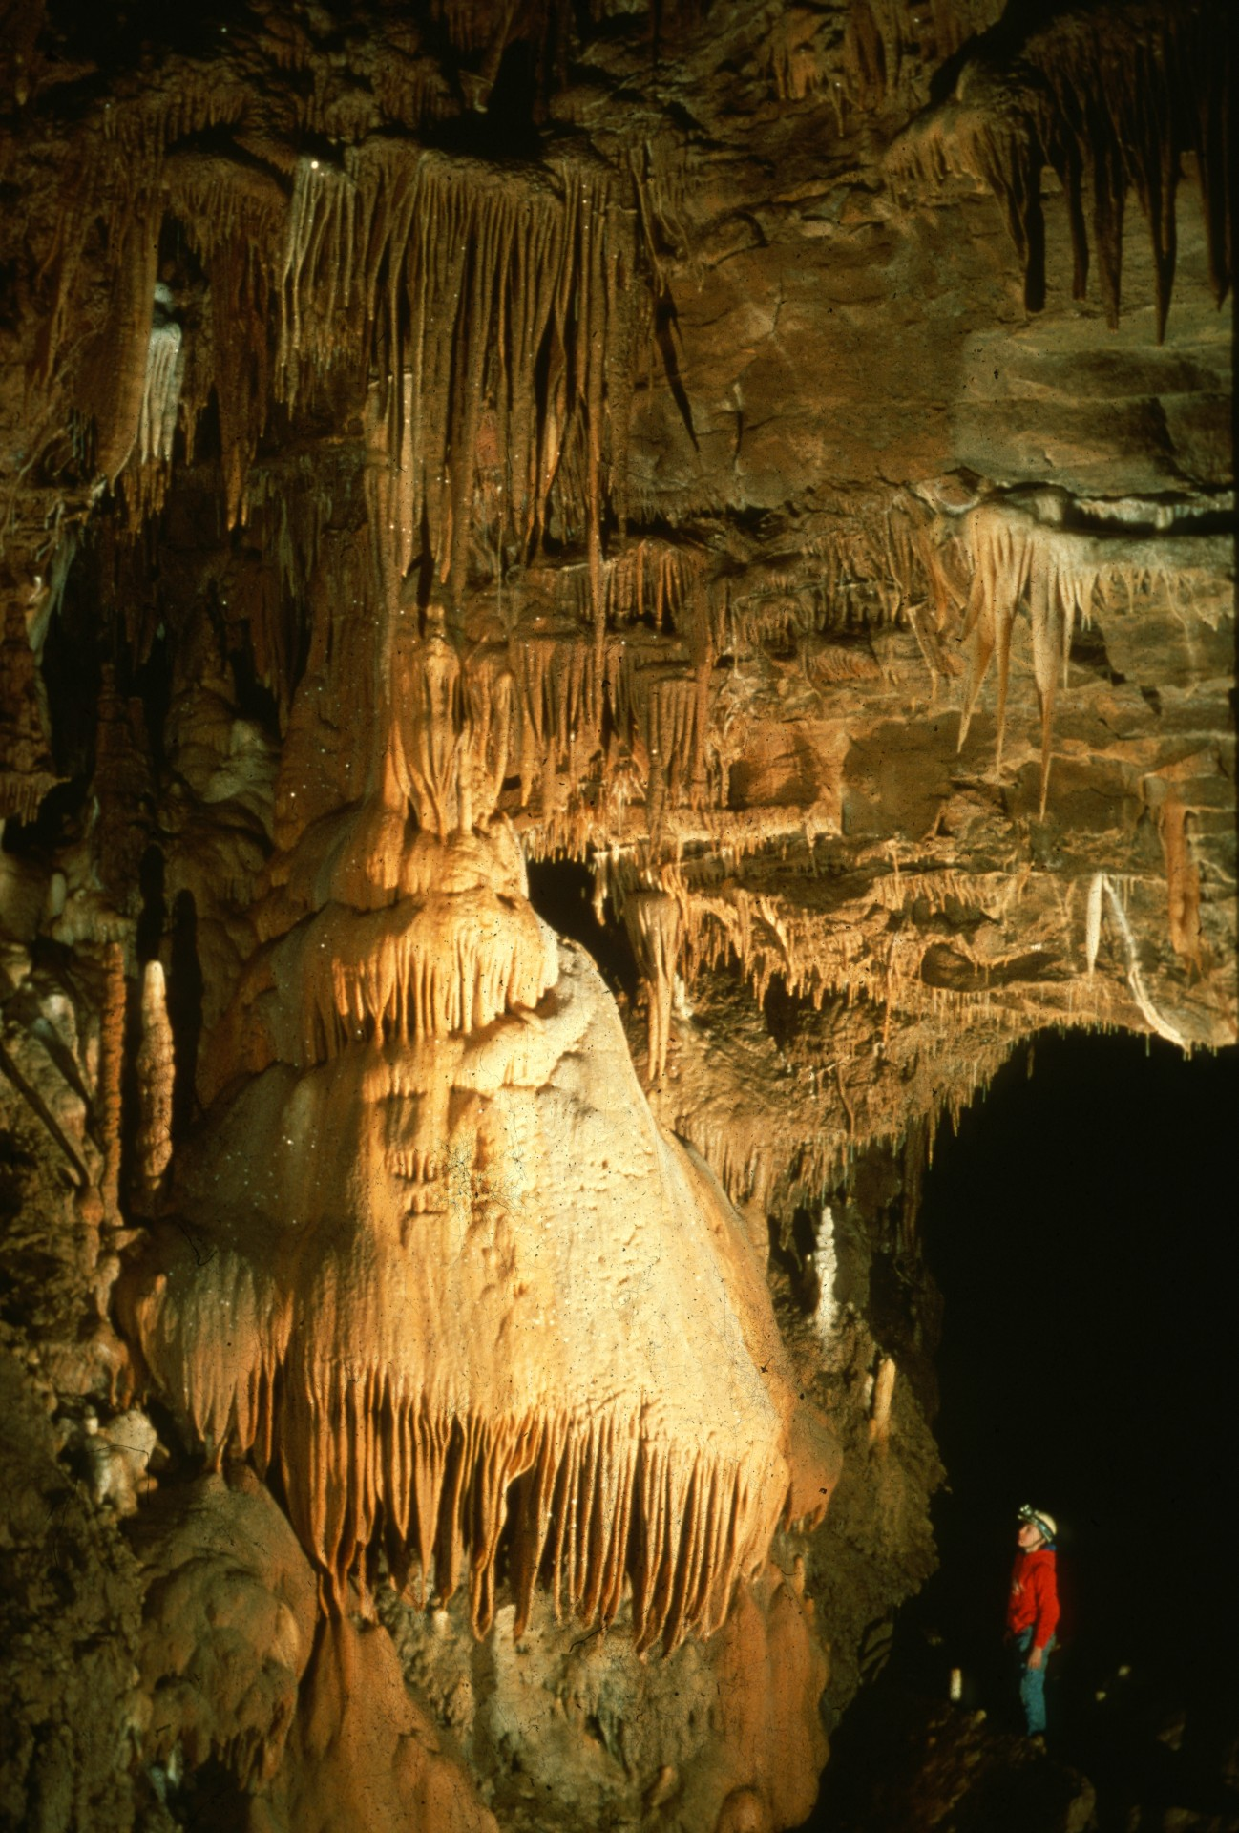
Notes:
CRYSTAL DOME – Rick Day

Slide 26
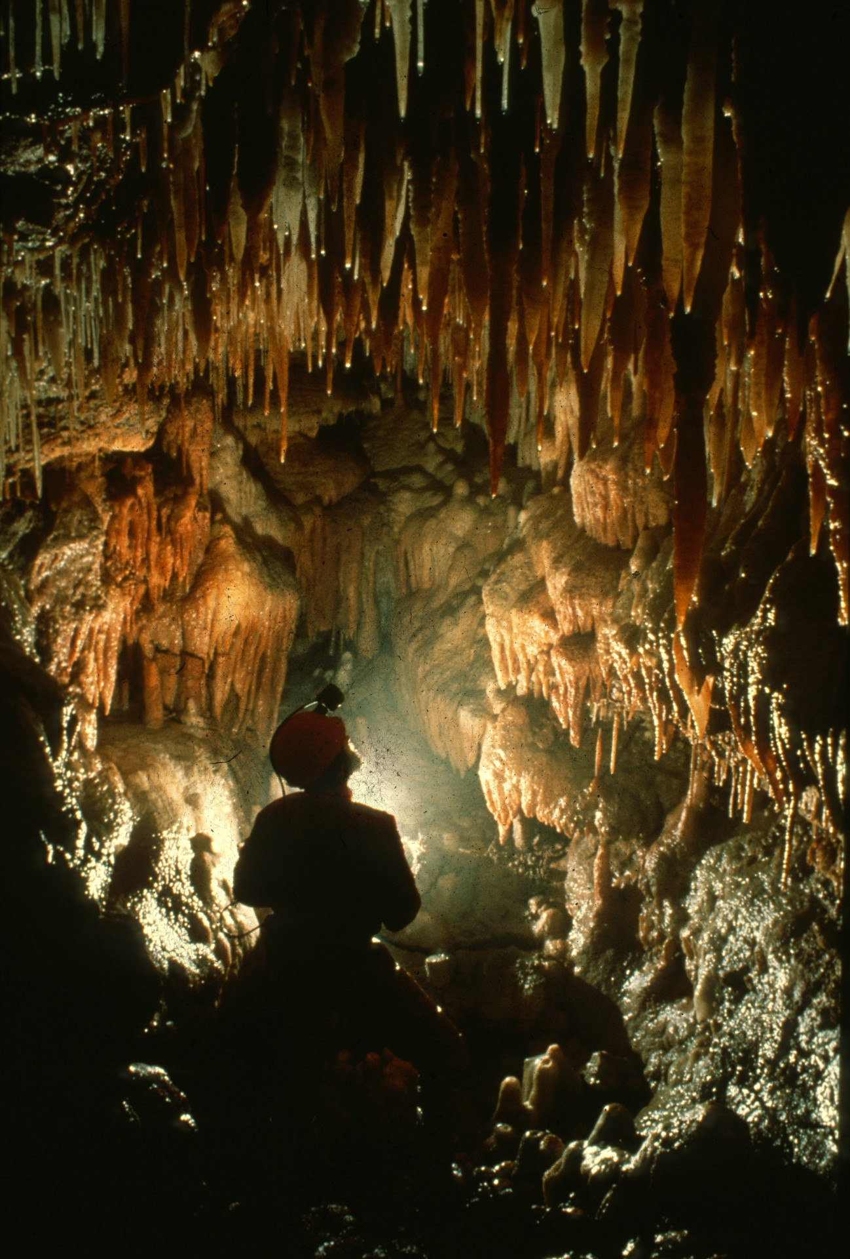
Notes:
KEVIN’S ROOM – Rick Day

Slide 27
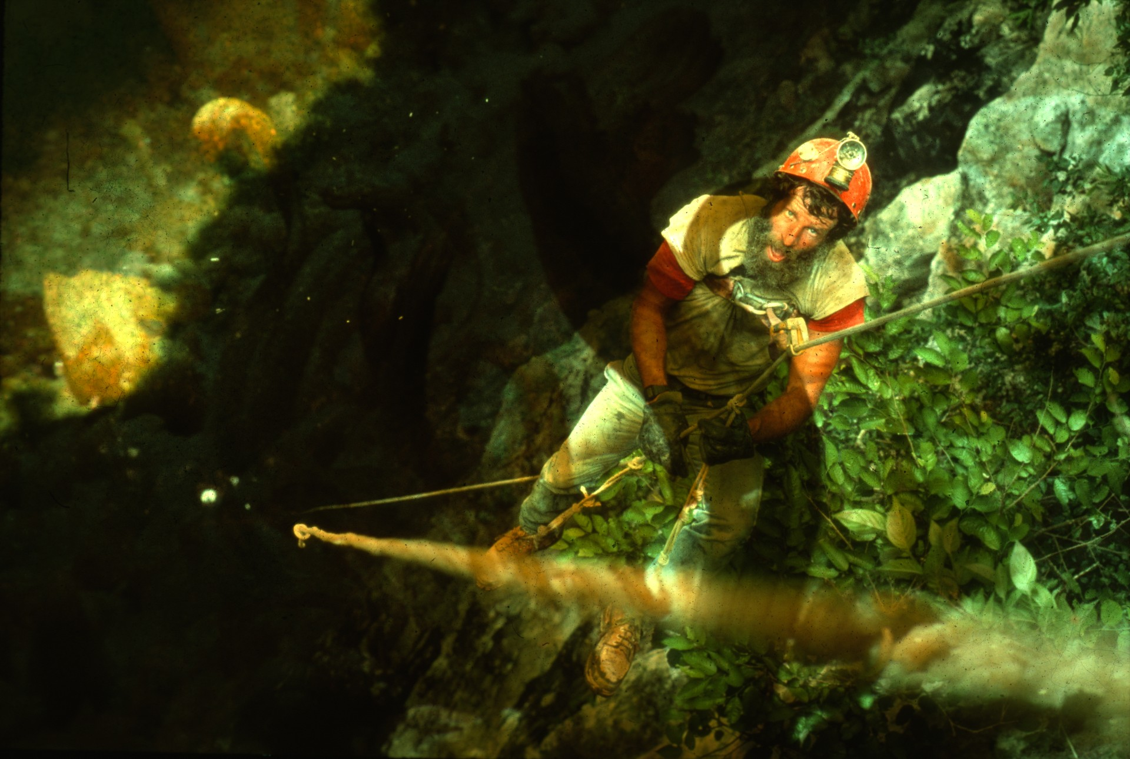
Notes:
THE LONG HAUL, HOYA DE GUAGUAS – Andy Grubbs

Slide 28
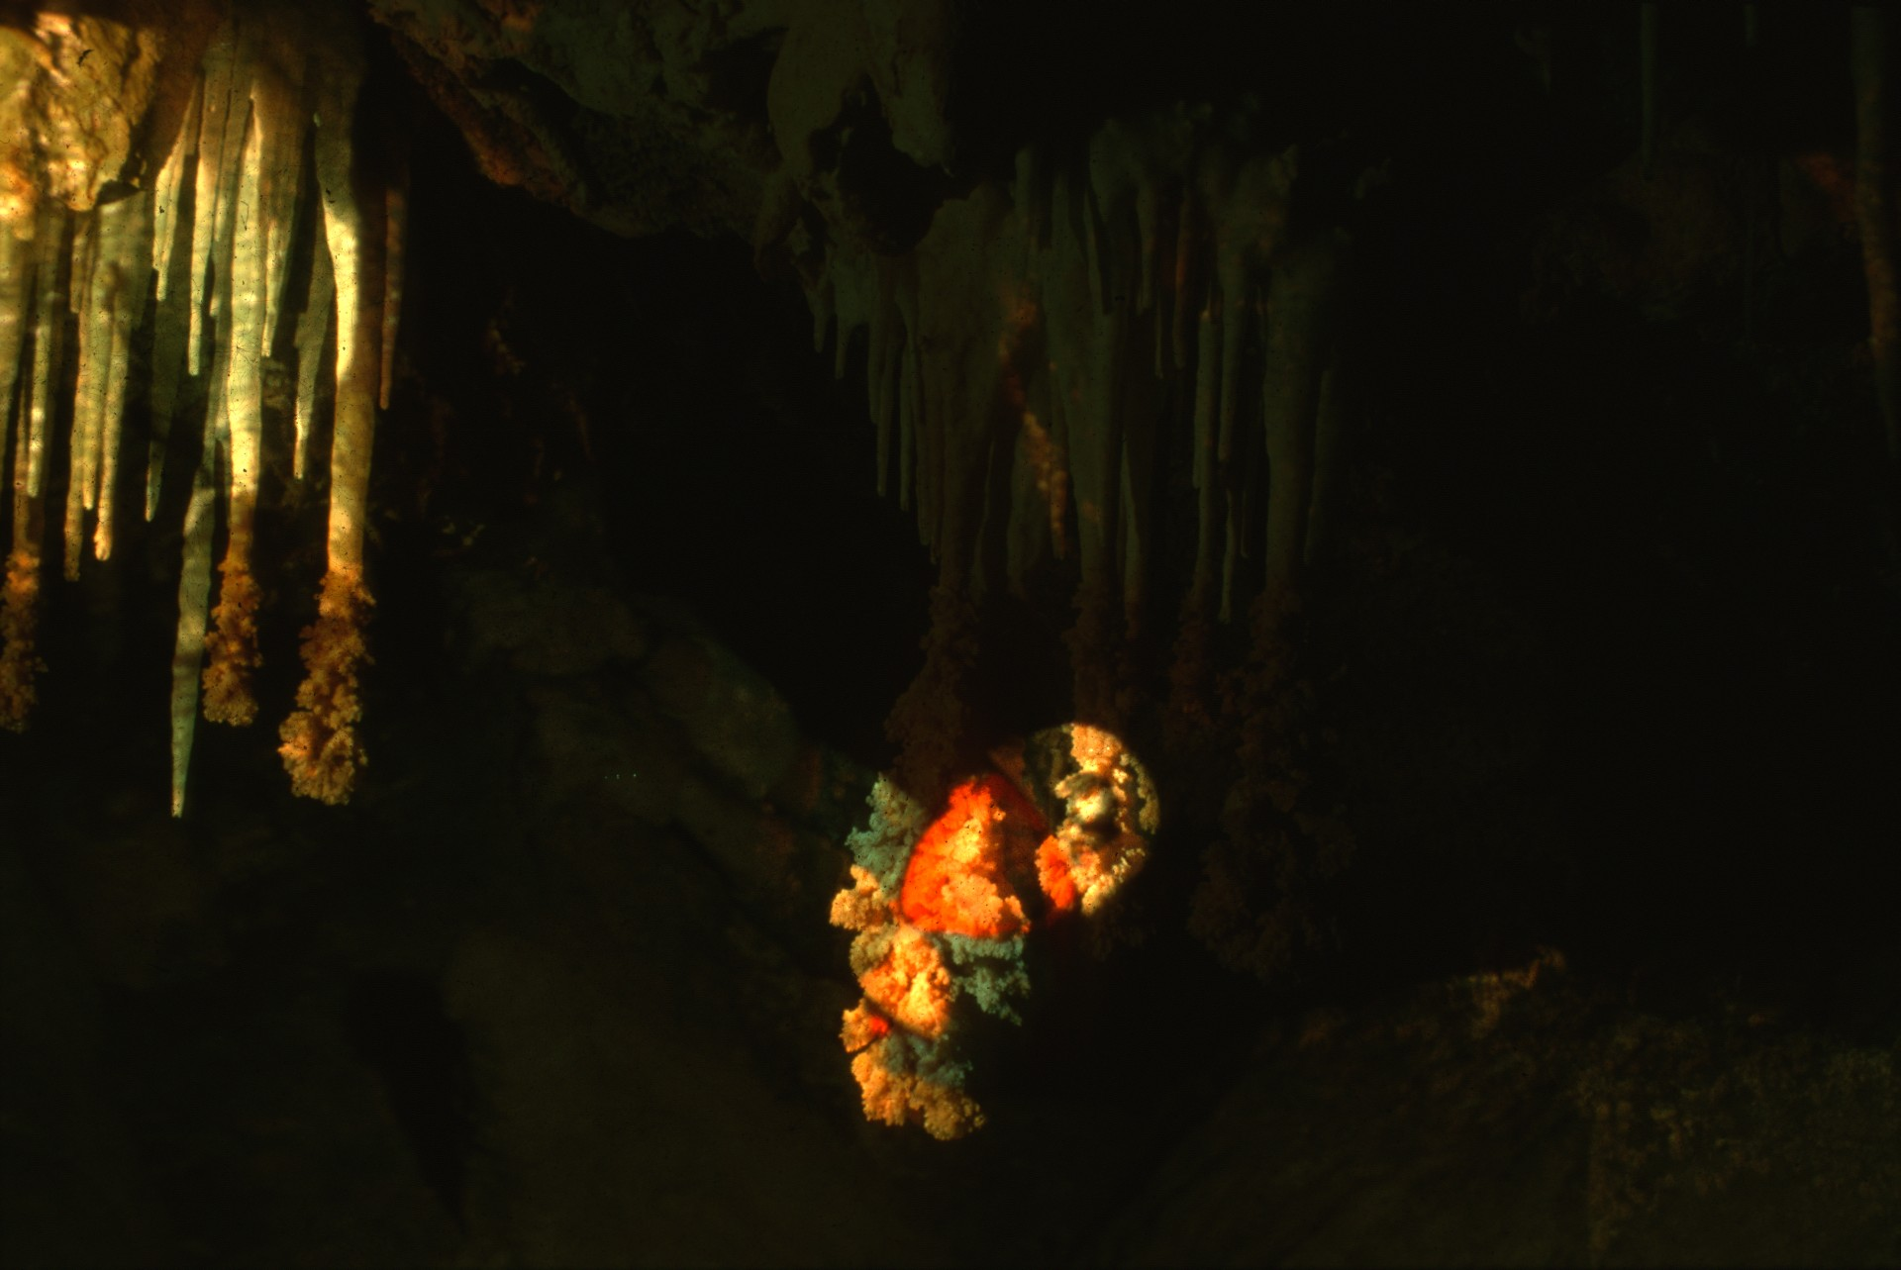
Notes:
IMPROPER PIT RIGGING – John Van Swearingen IV

Slide 29
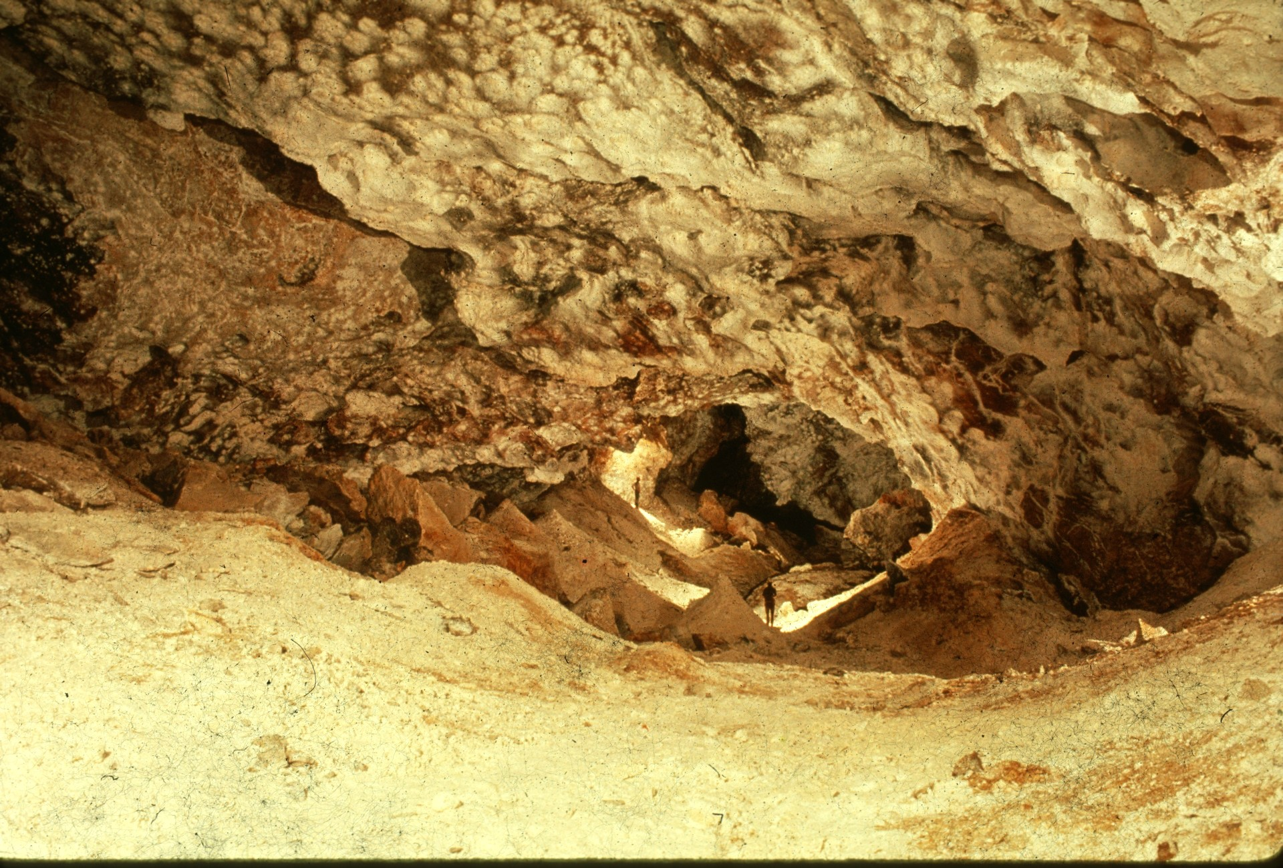
Notes:
BIRTHDAY PASSAGE DELIGHTS – Andy Grubbs

Slide 30
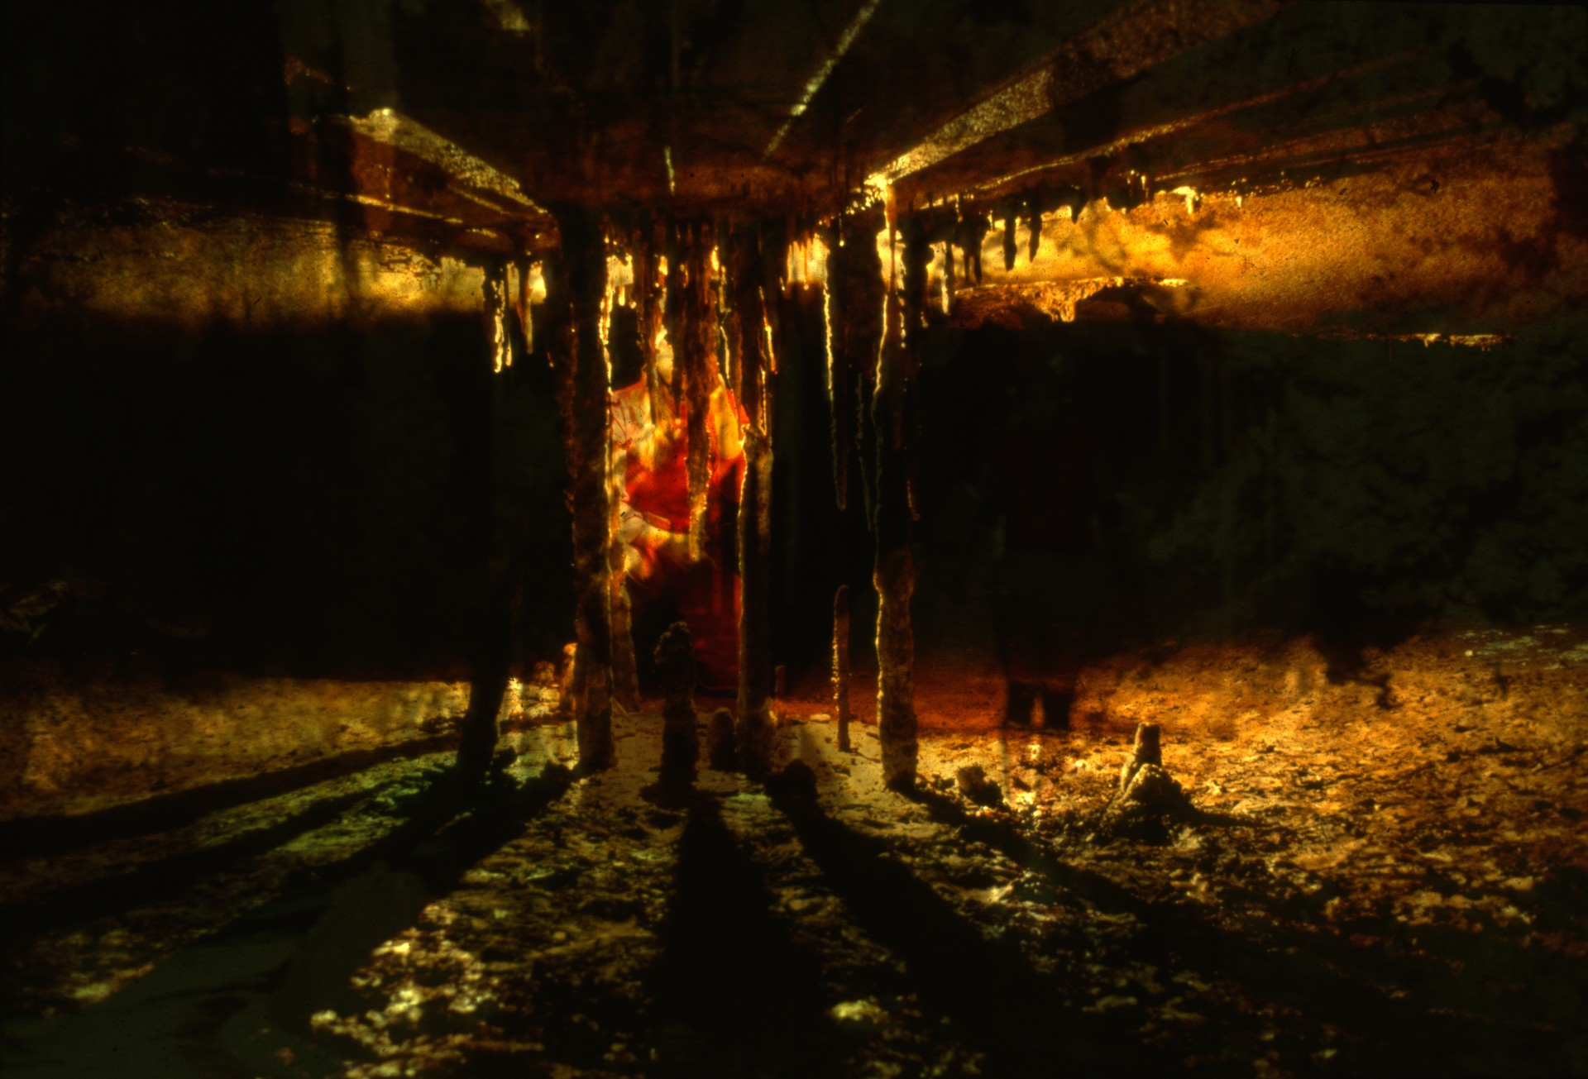
Notes:
VERTICAL ARRANGMENT II – Jim Loftin

Slide 31
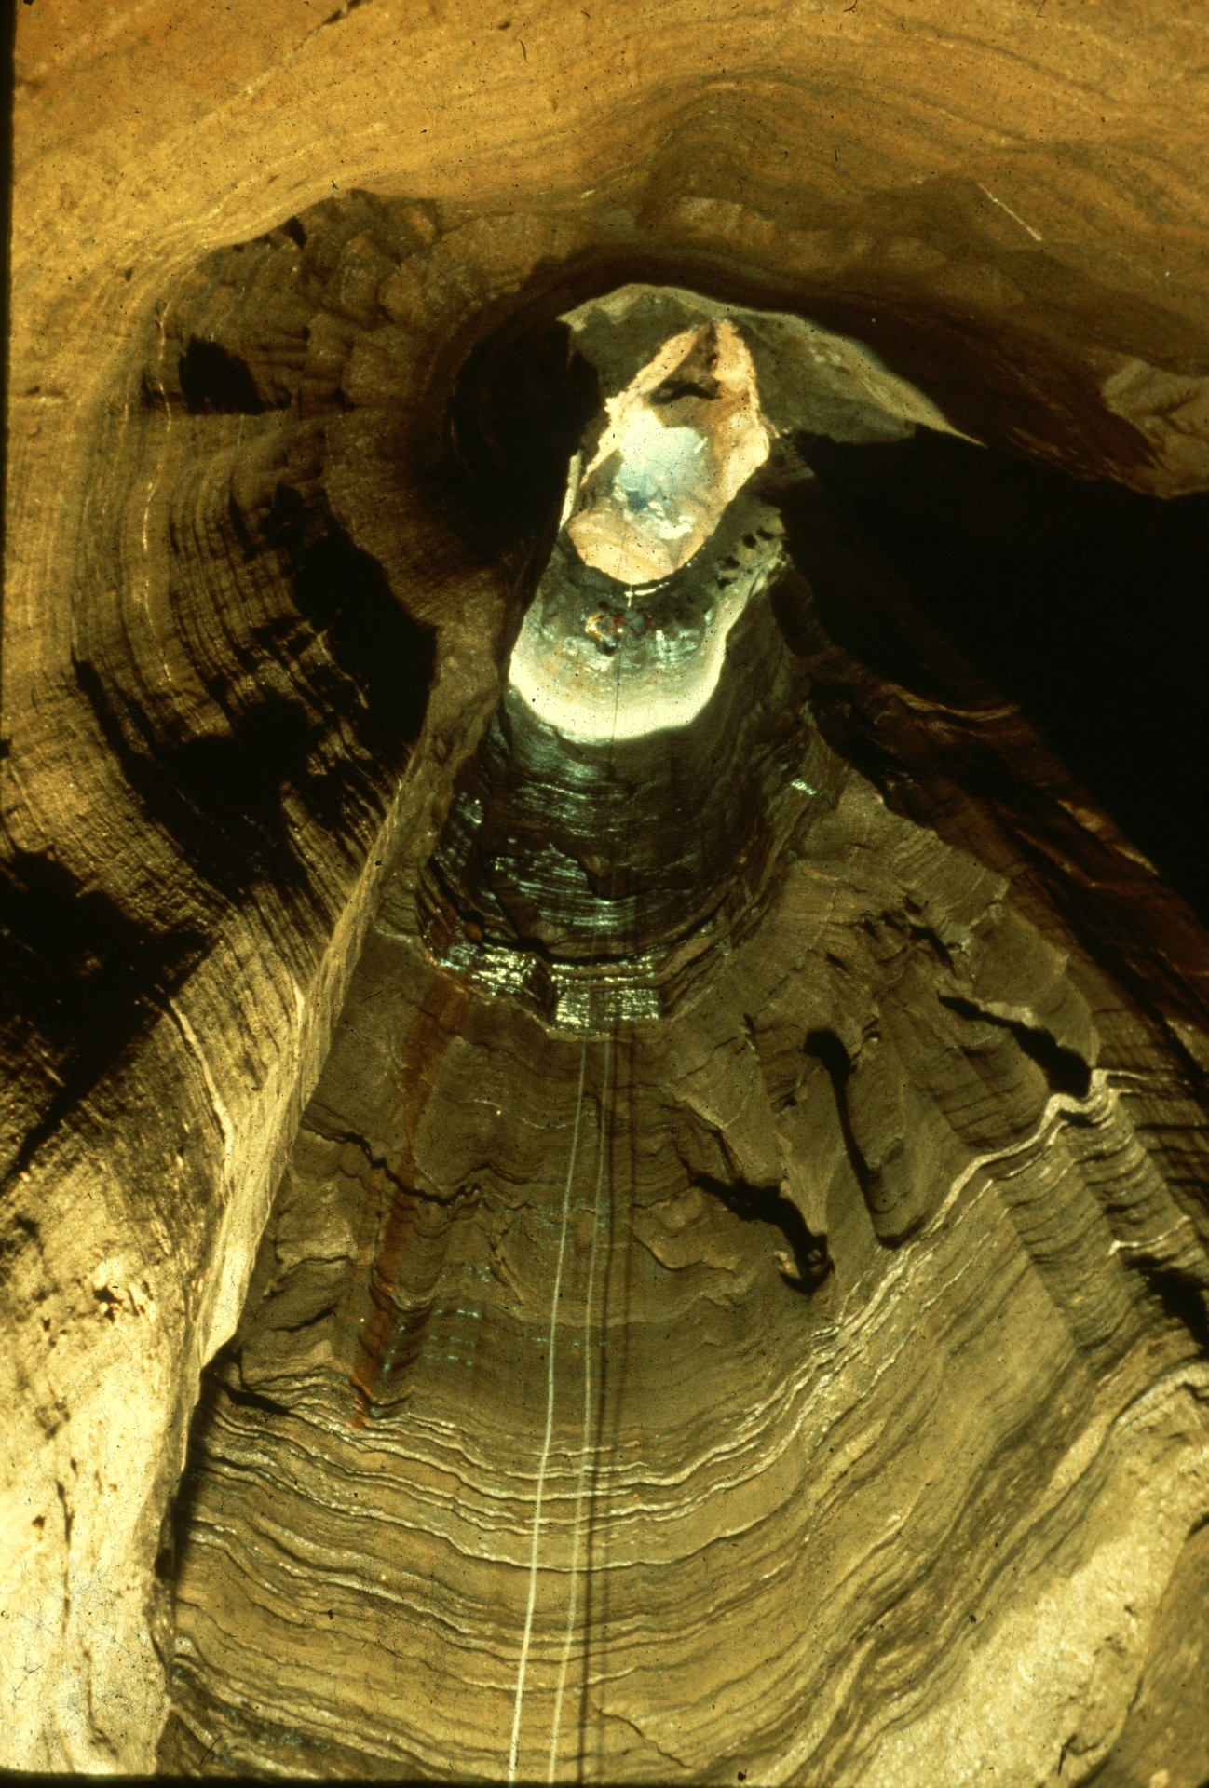
Notes:
FARGO WELL – Jim Loftin

Slide 32
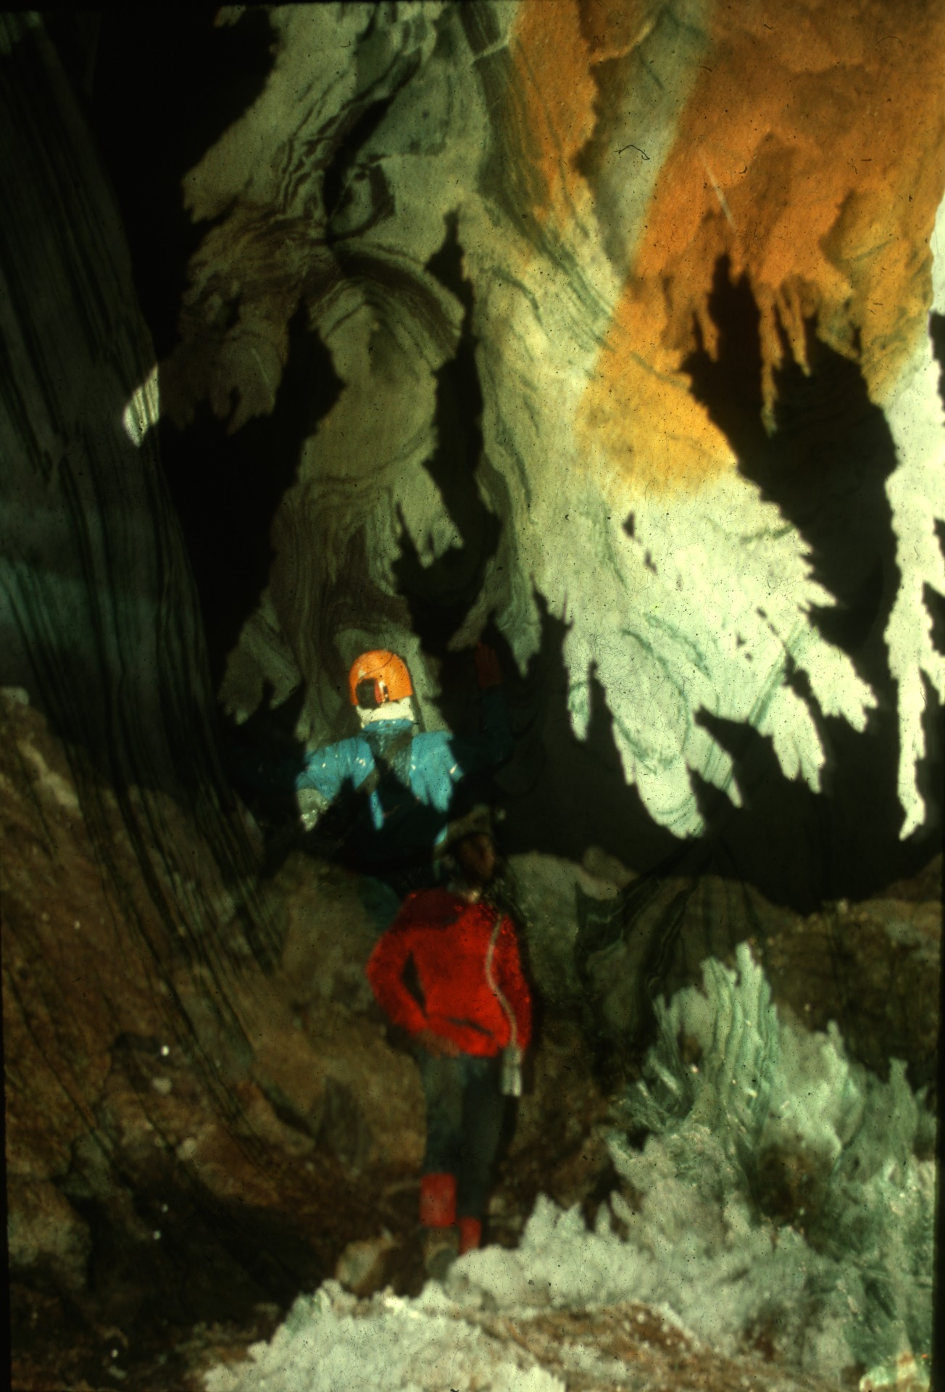
Notes:
SELENITE SPLENDOR – Peter & Ann Bosted

Slide 33
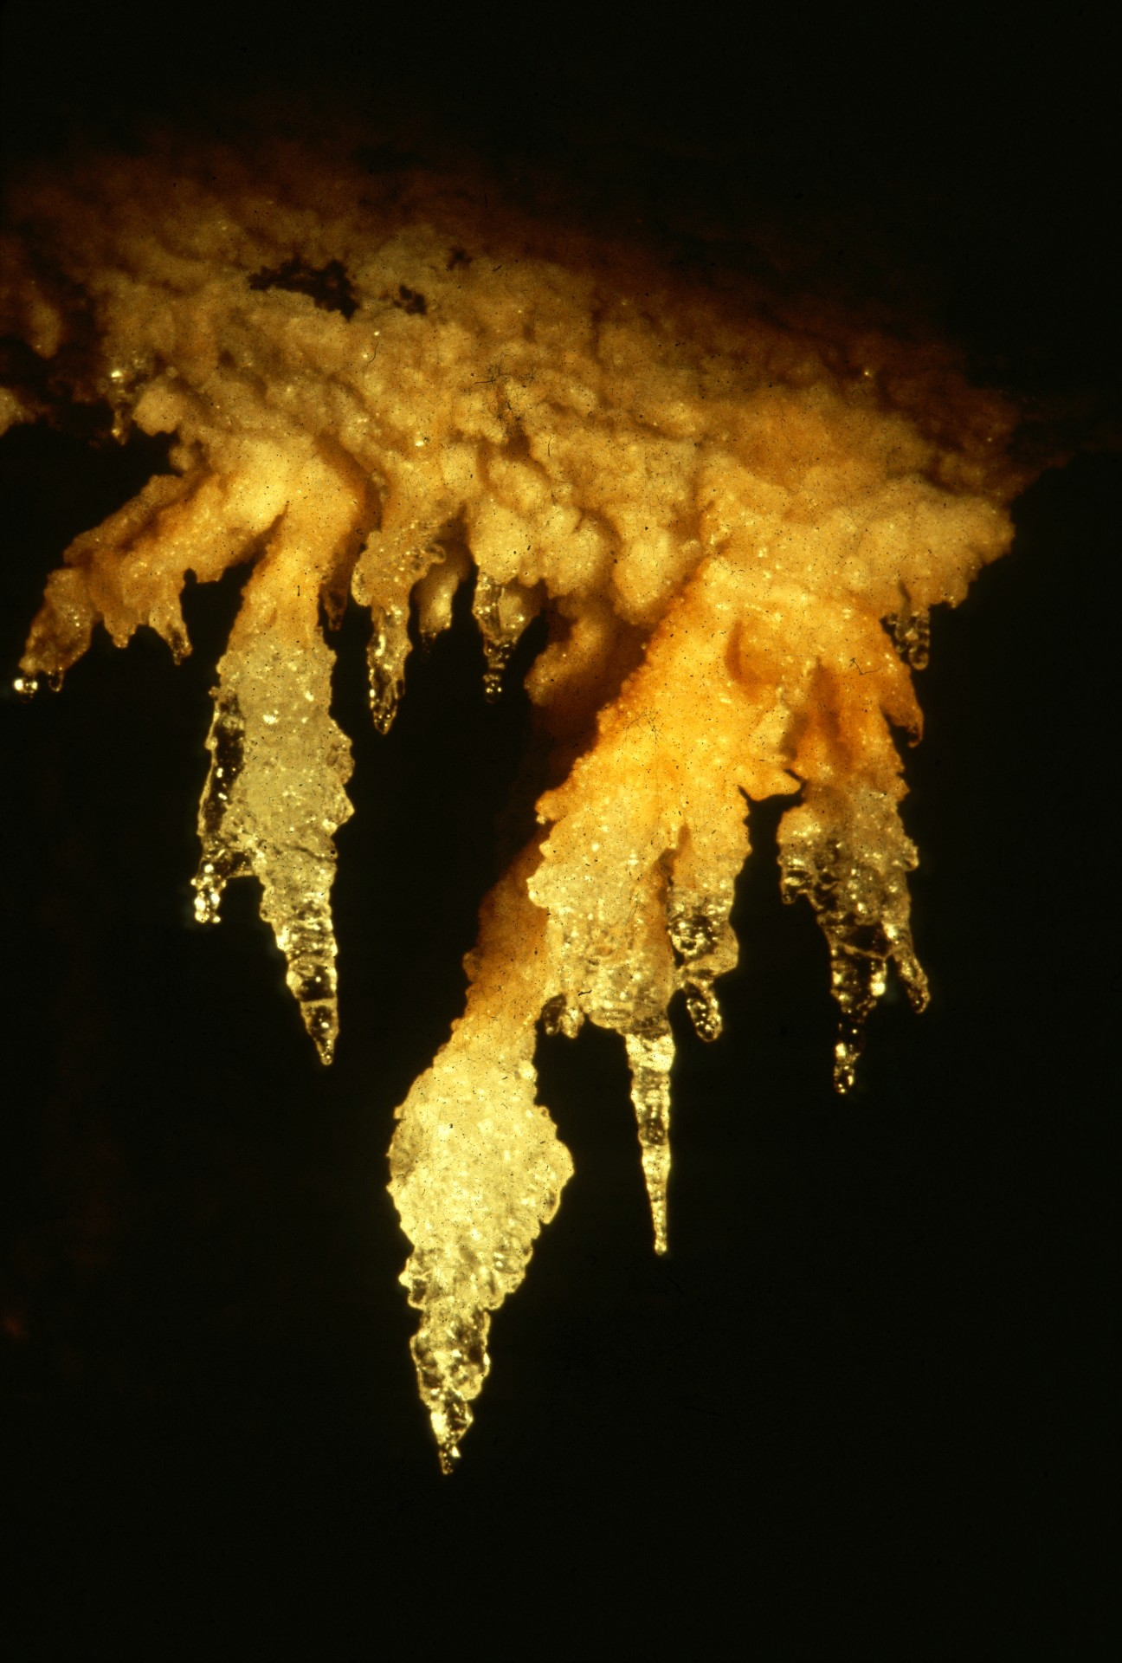
Notes:
POLAR ICE – Maureen Handler

Slide 34
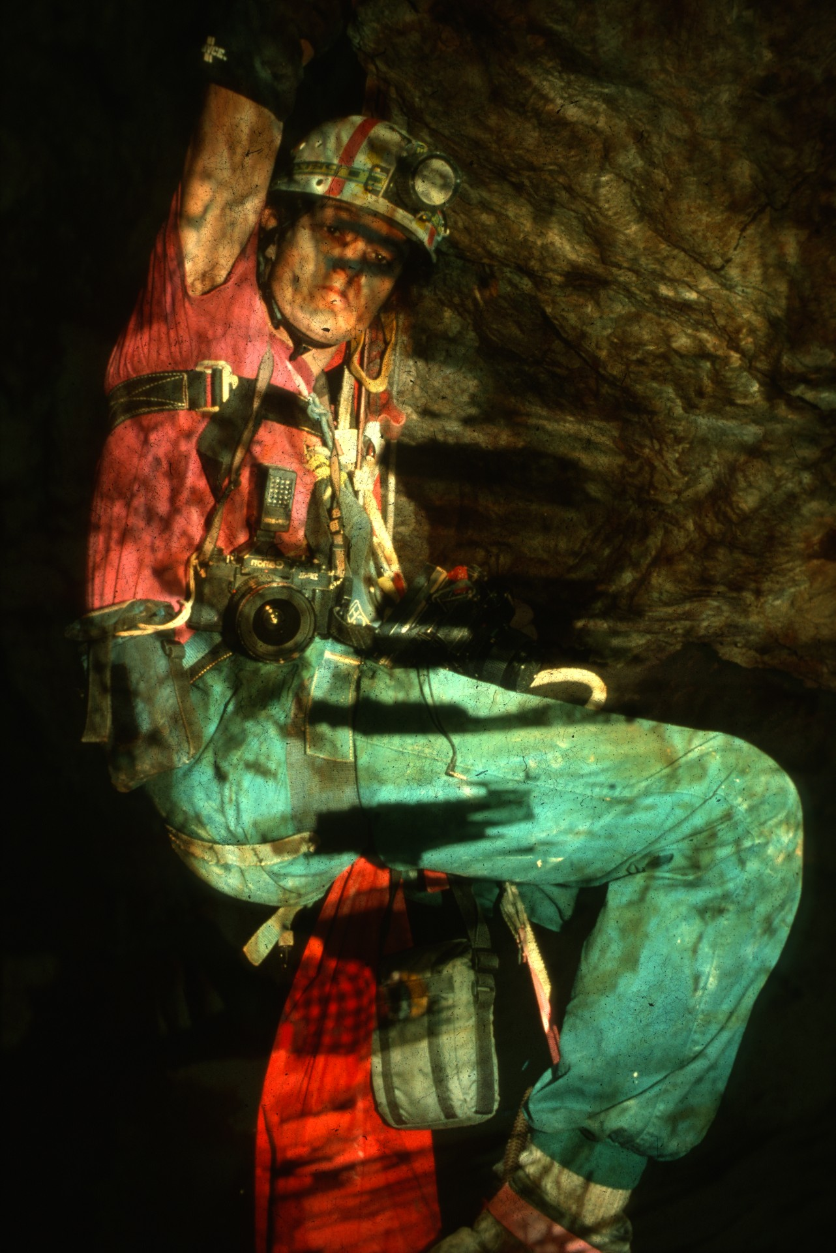
Notes:
THE PHOTOGRAPHER – Robert Montgomery

Slide 35
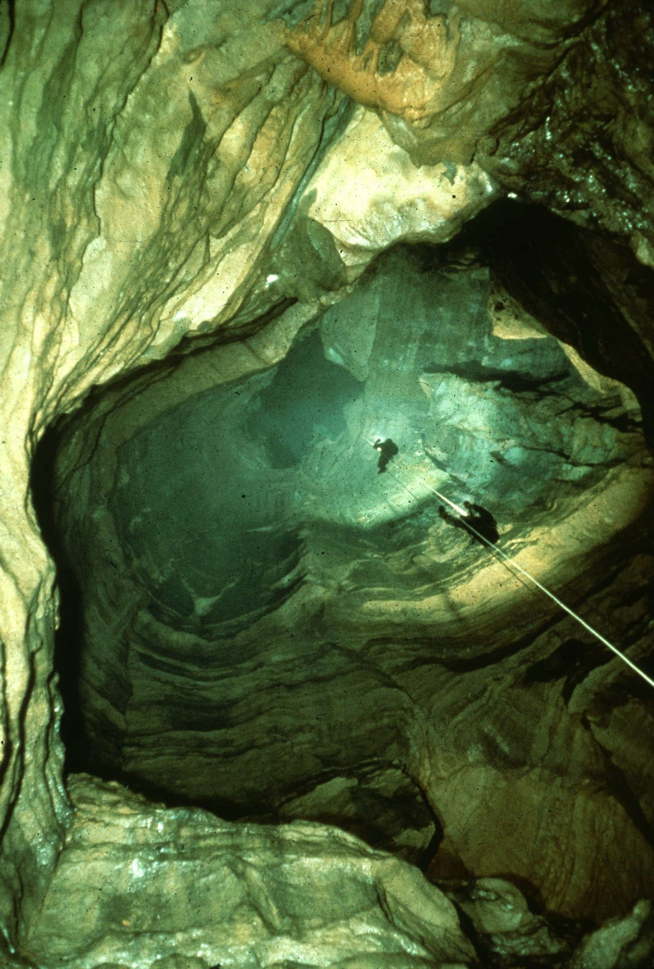
Notes:
NATURAL WELL – John Van Swearingen IV

Slide 36
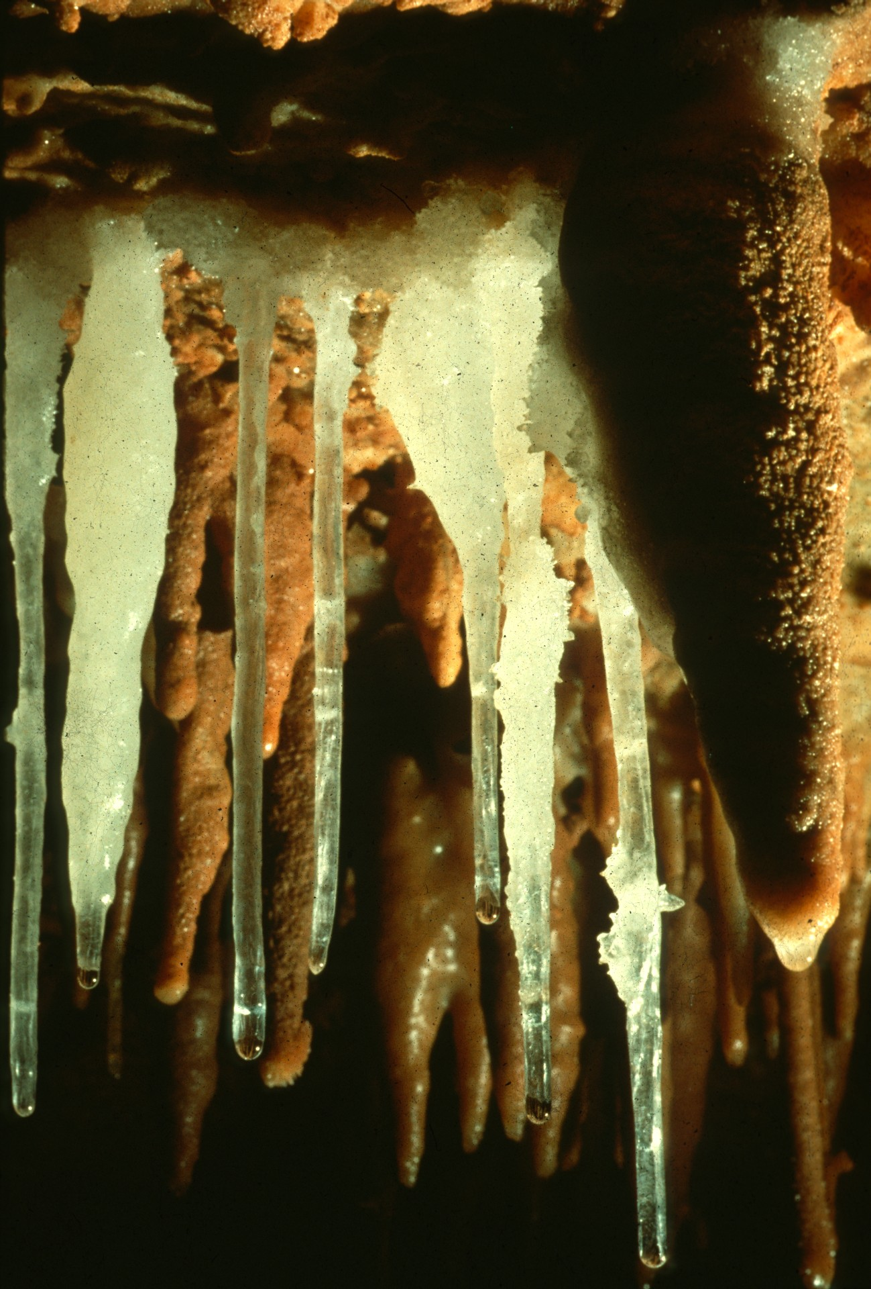
Notes:
CLARITIES – Rick Day

Slide 37
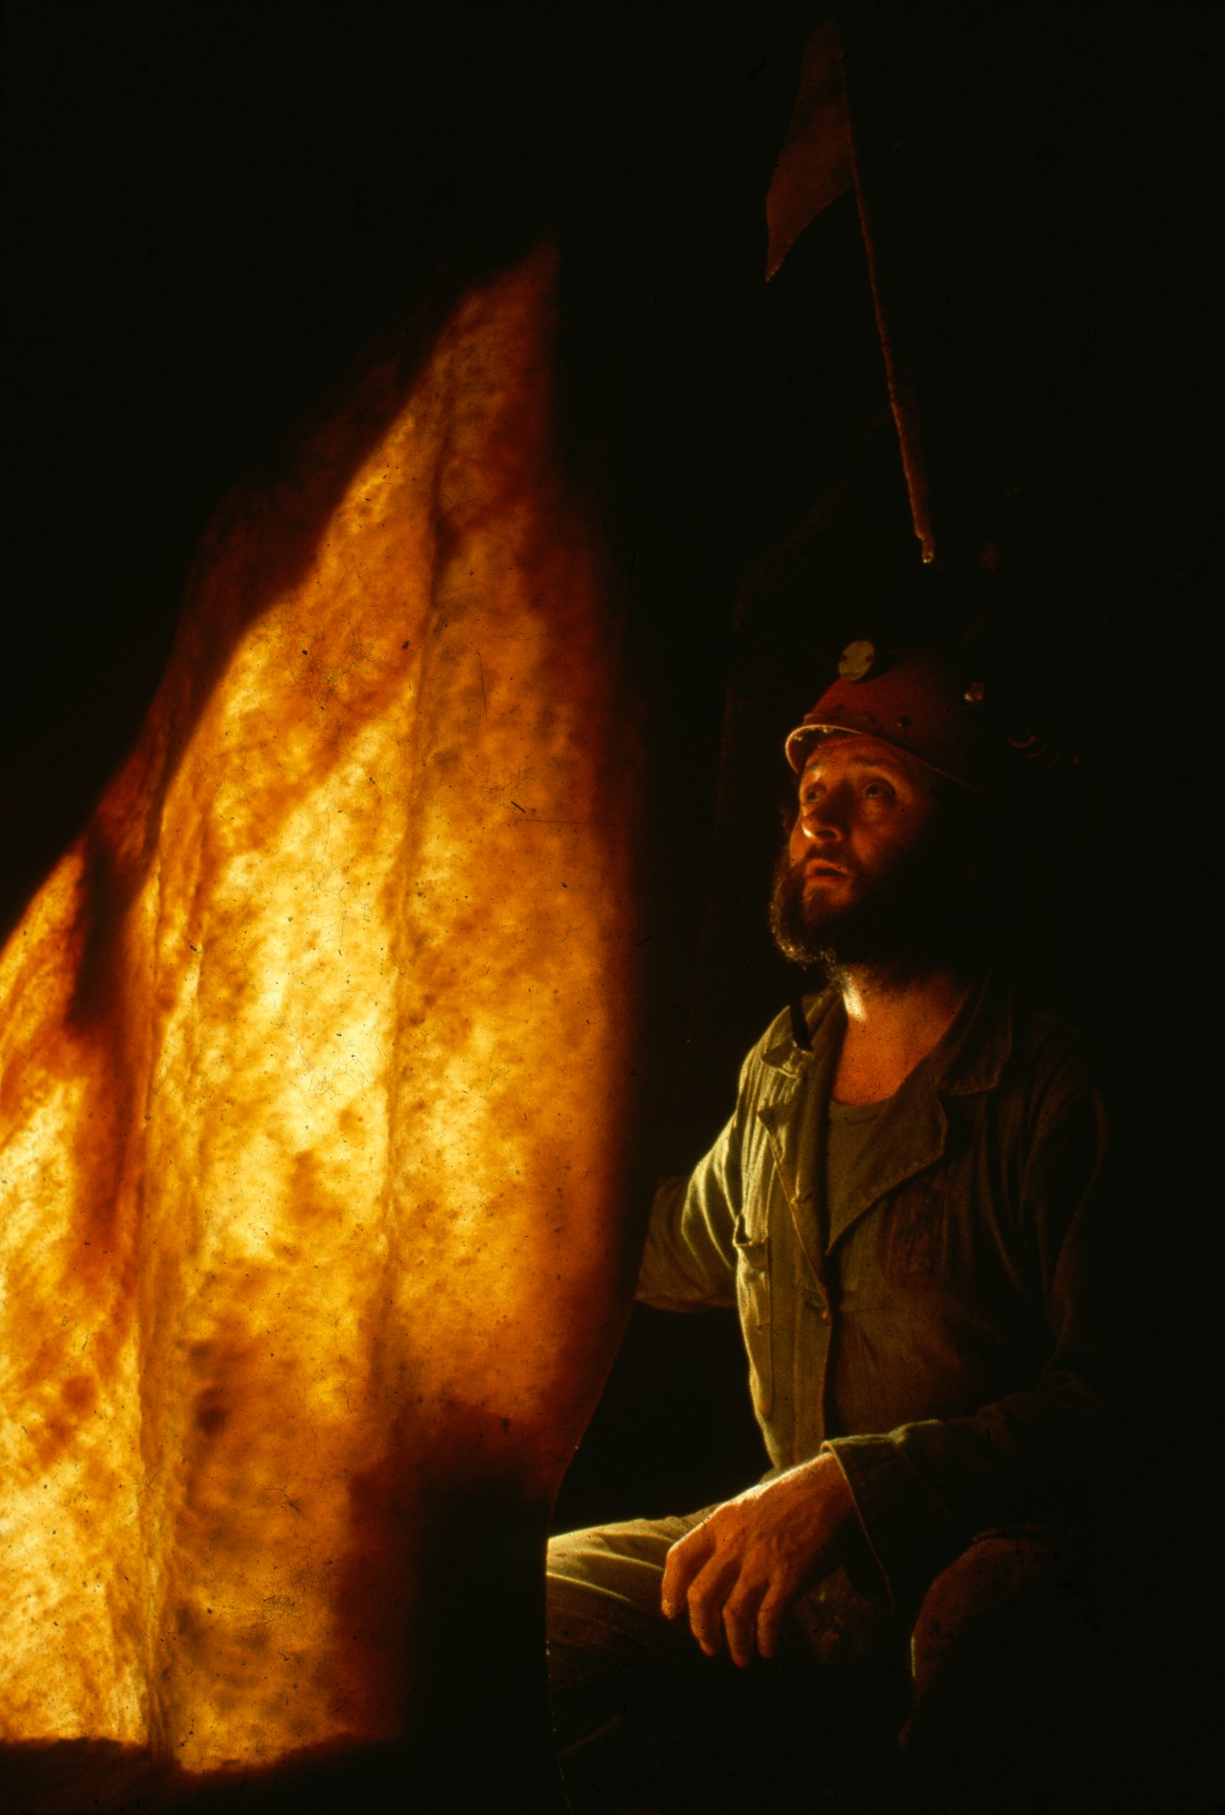
Notes:
THE FLAME – Rick Day

Slide 38
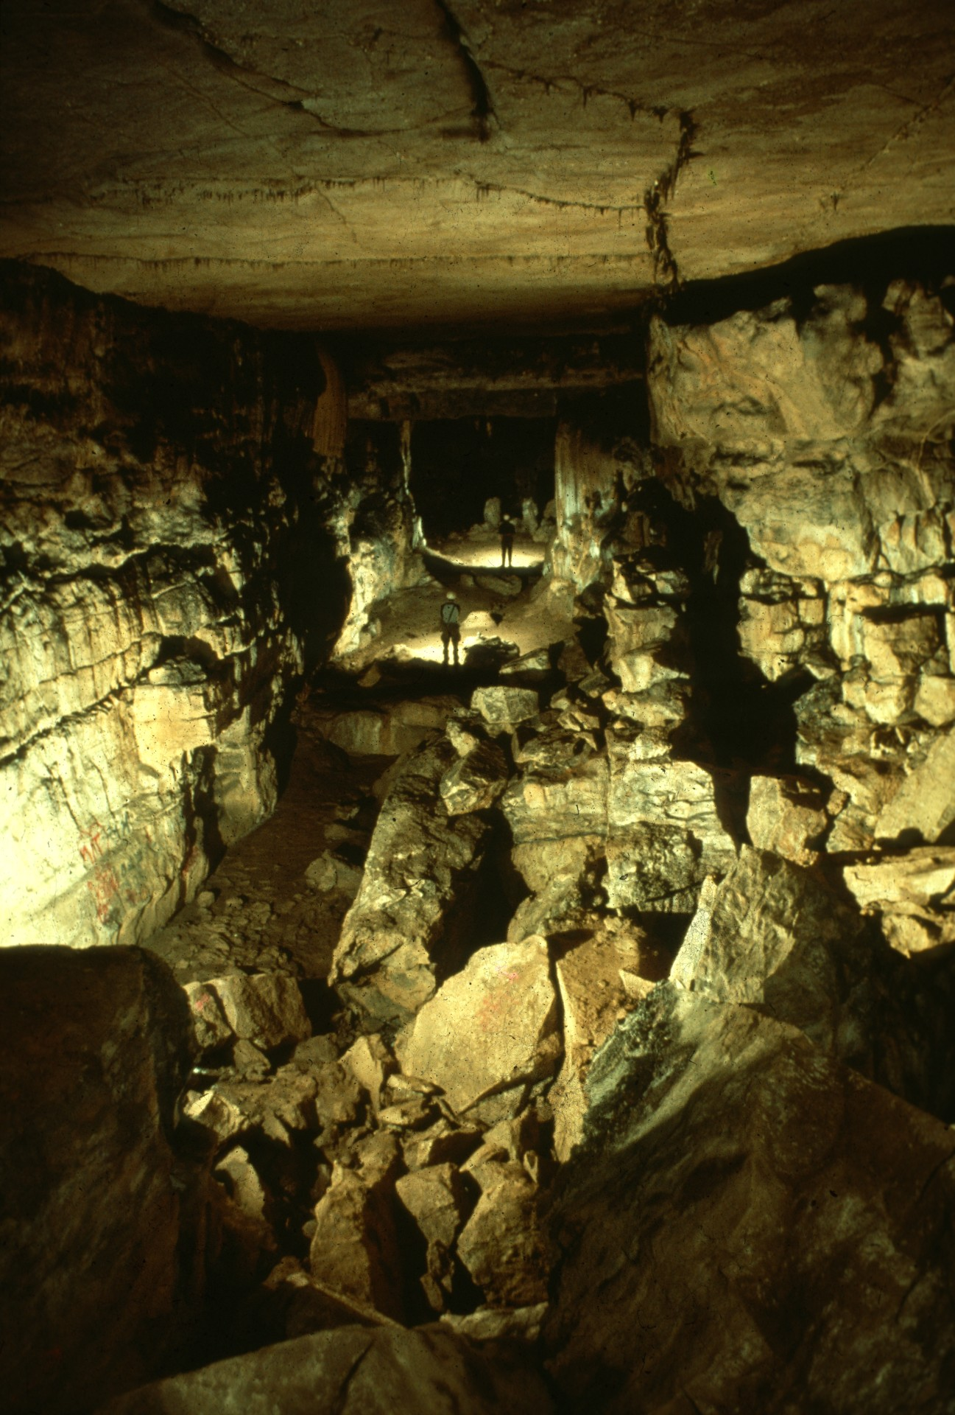
Notes:
PETTIJOHN’S ENTRANCE ROOM – Jeff & Alexis Harris

Slide 39
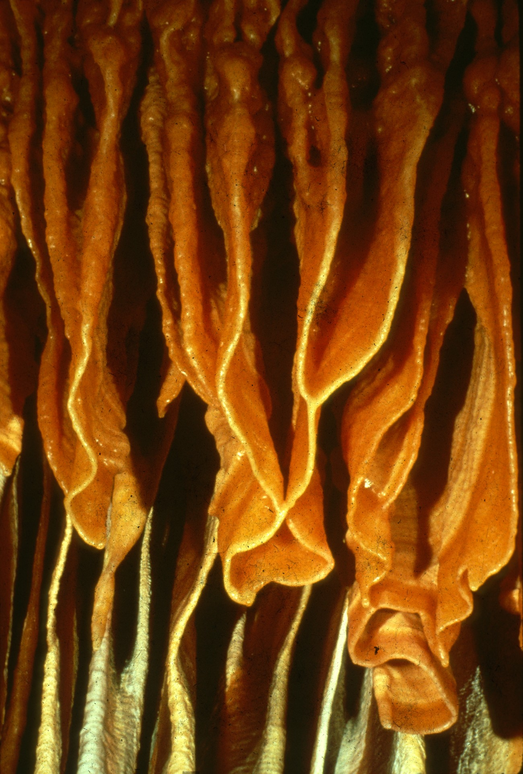
Notes:
GOLDEN CONVOLUTIONS – Peter & Ann Bosted

Slide 40
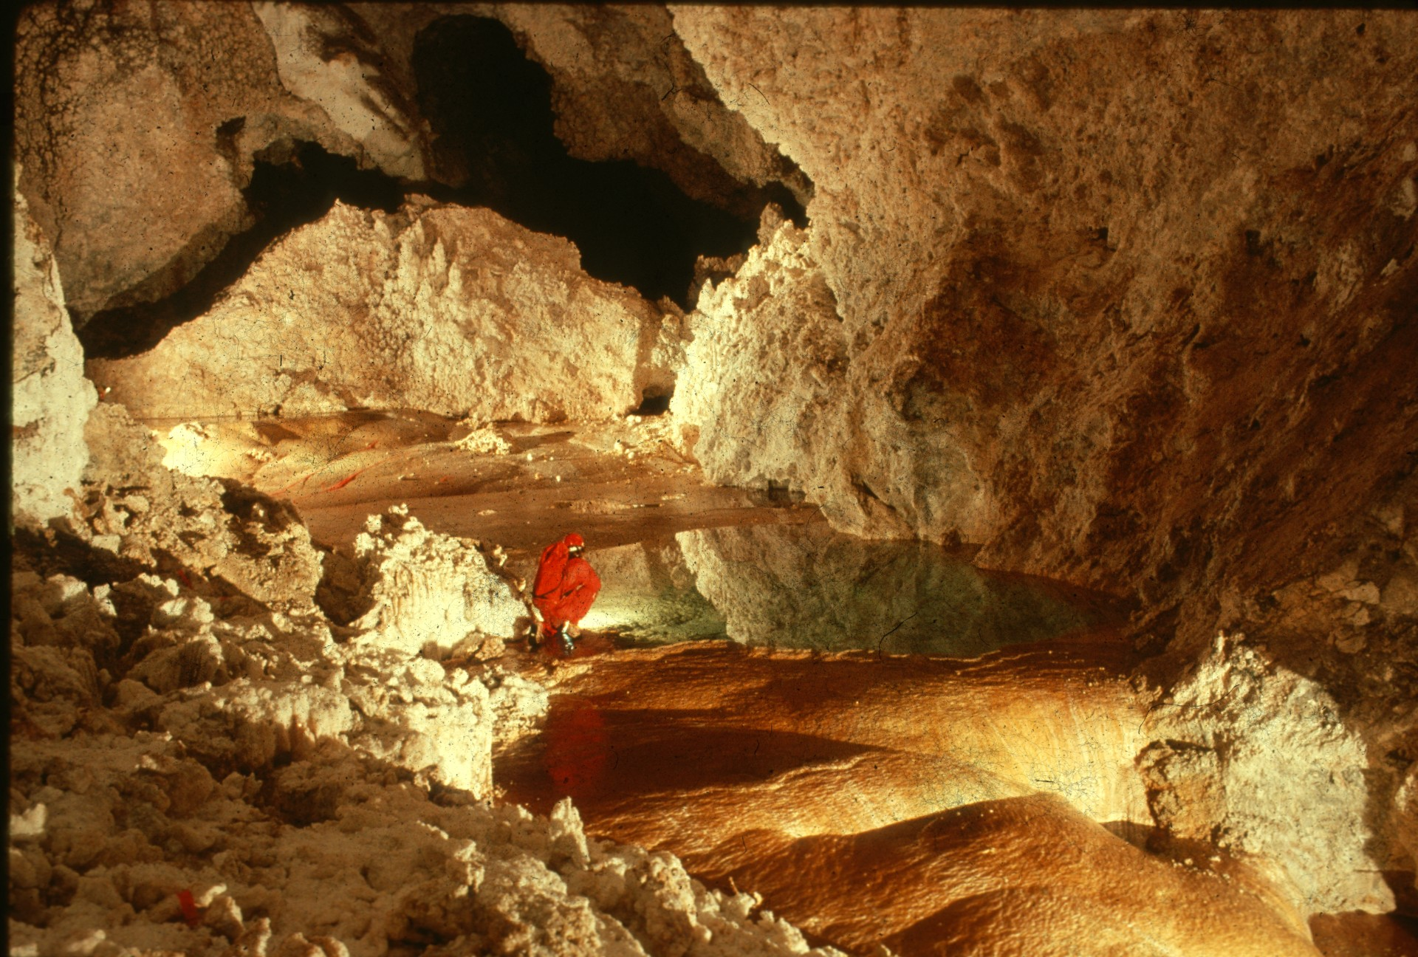
Notes:
GYPSUM REFLECTIONS – Dave Bunnell

Slide 41
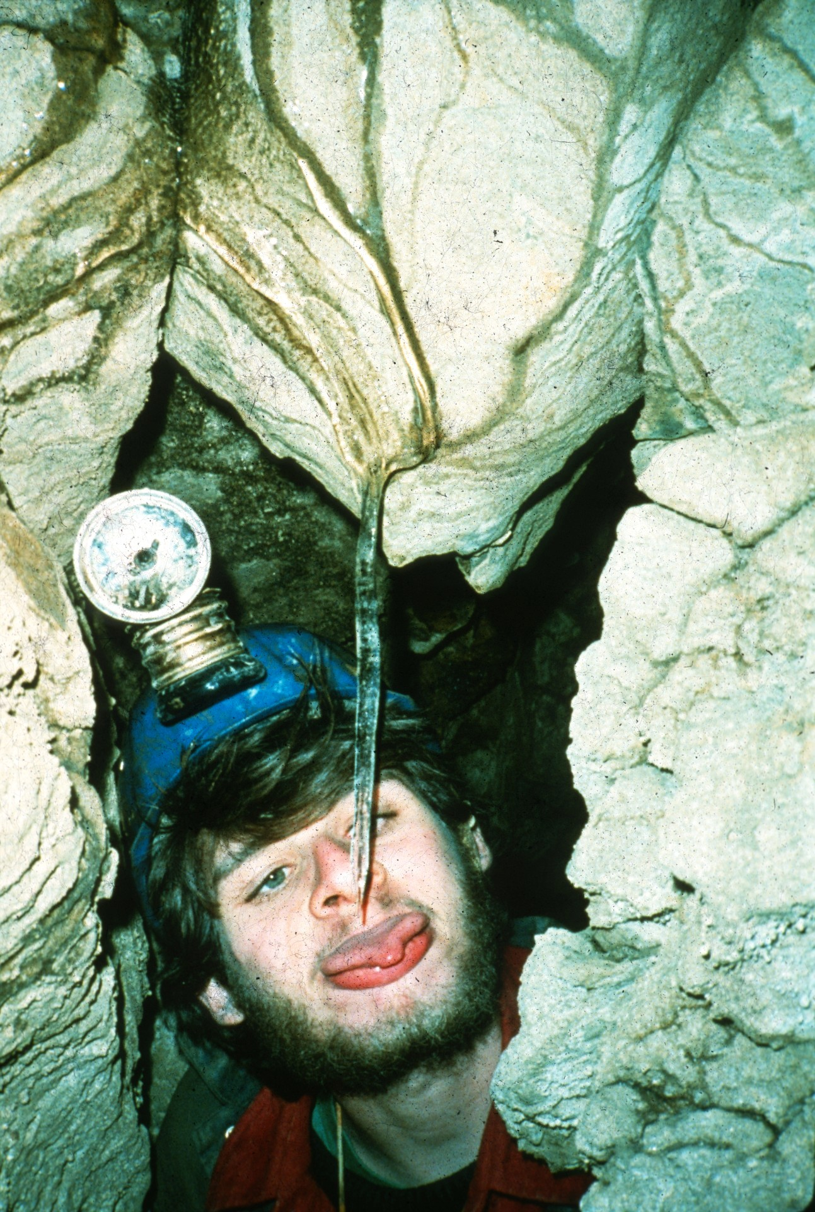
Notes:
QUENCHER! – Dorothy Eckert

Slide 42

HONORABLE MENTION
PHOTO SALON

Slide 43
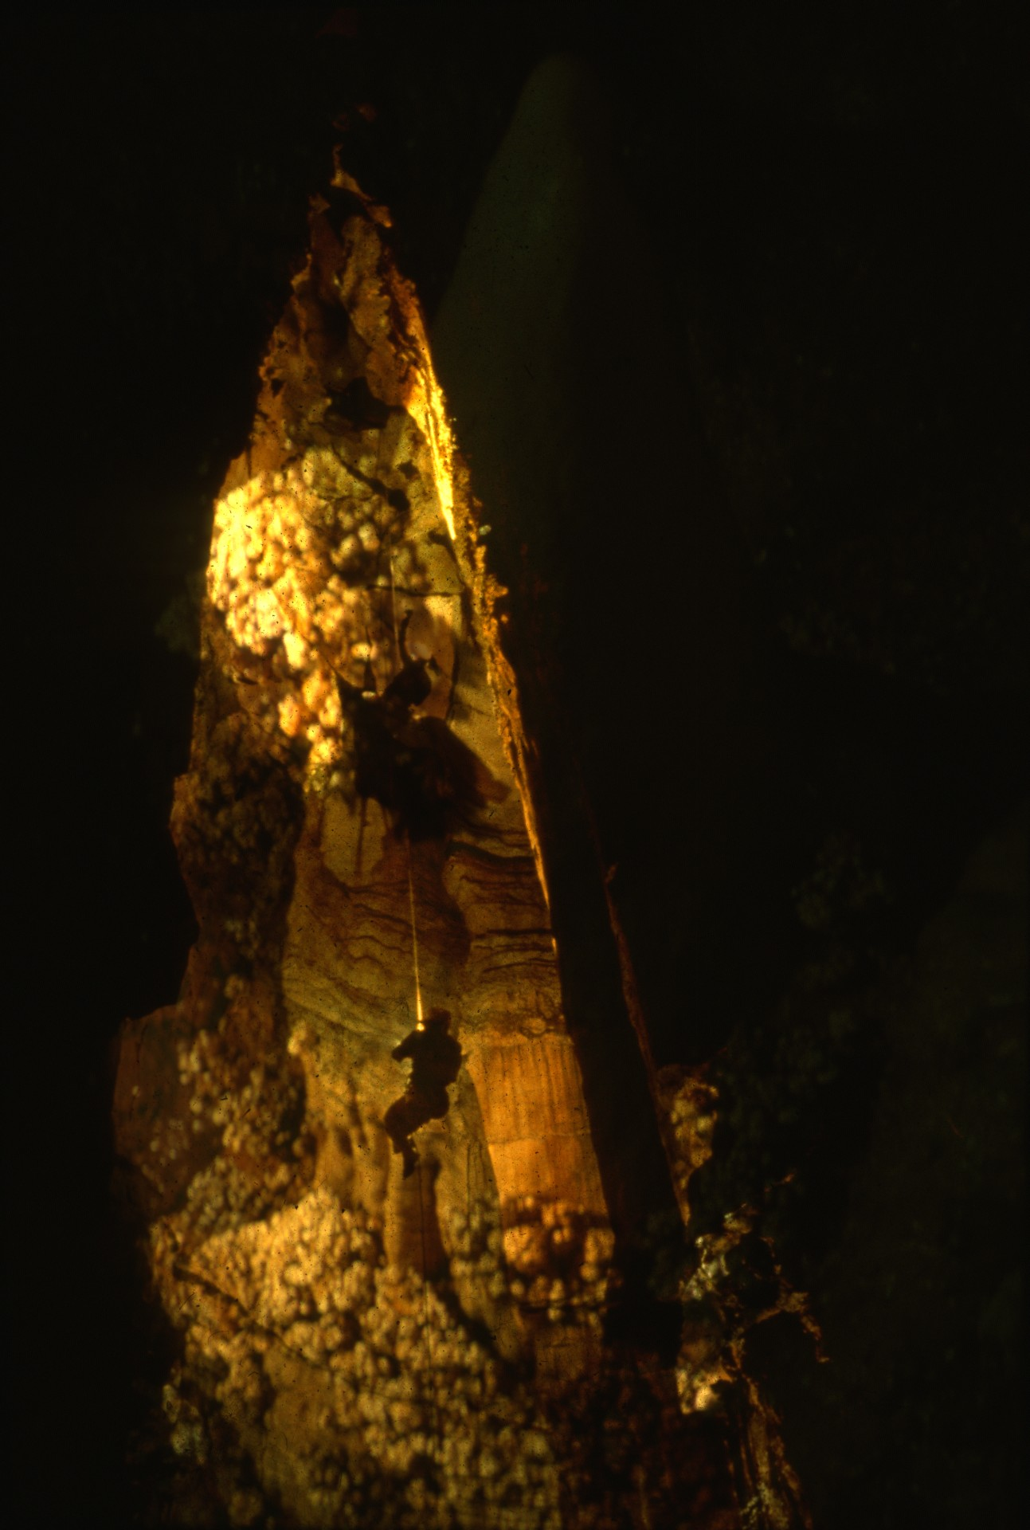
Notes:
TO THE DOME – John Van Swearingen IV

Slide 44
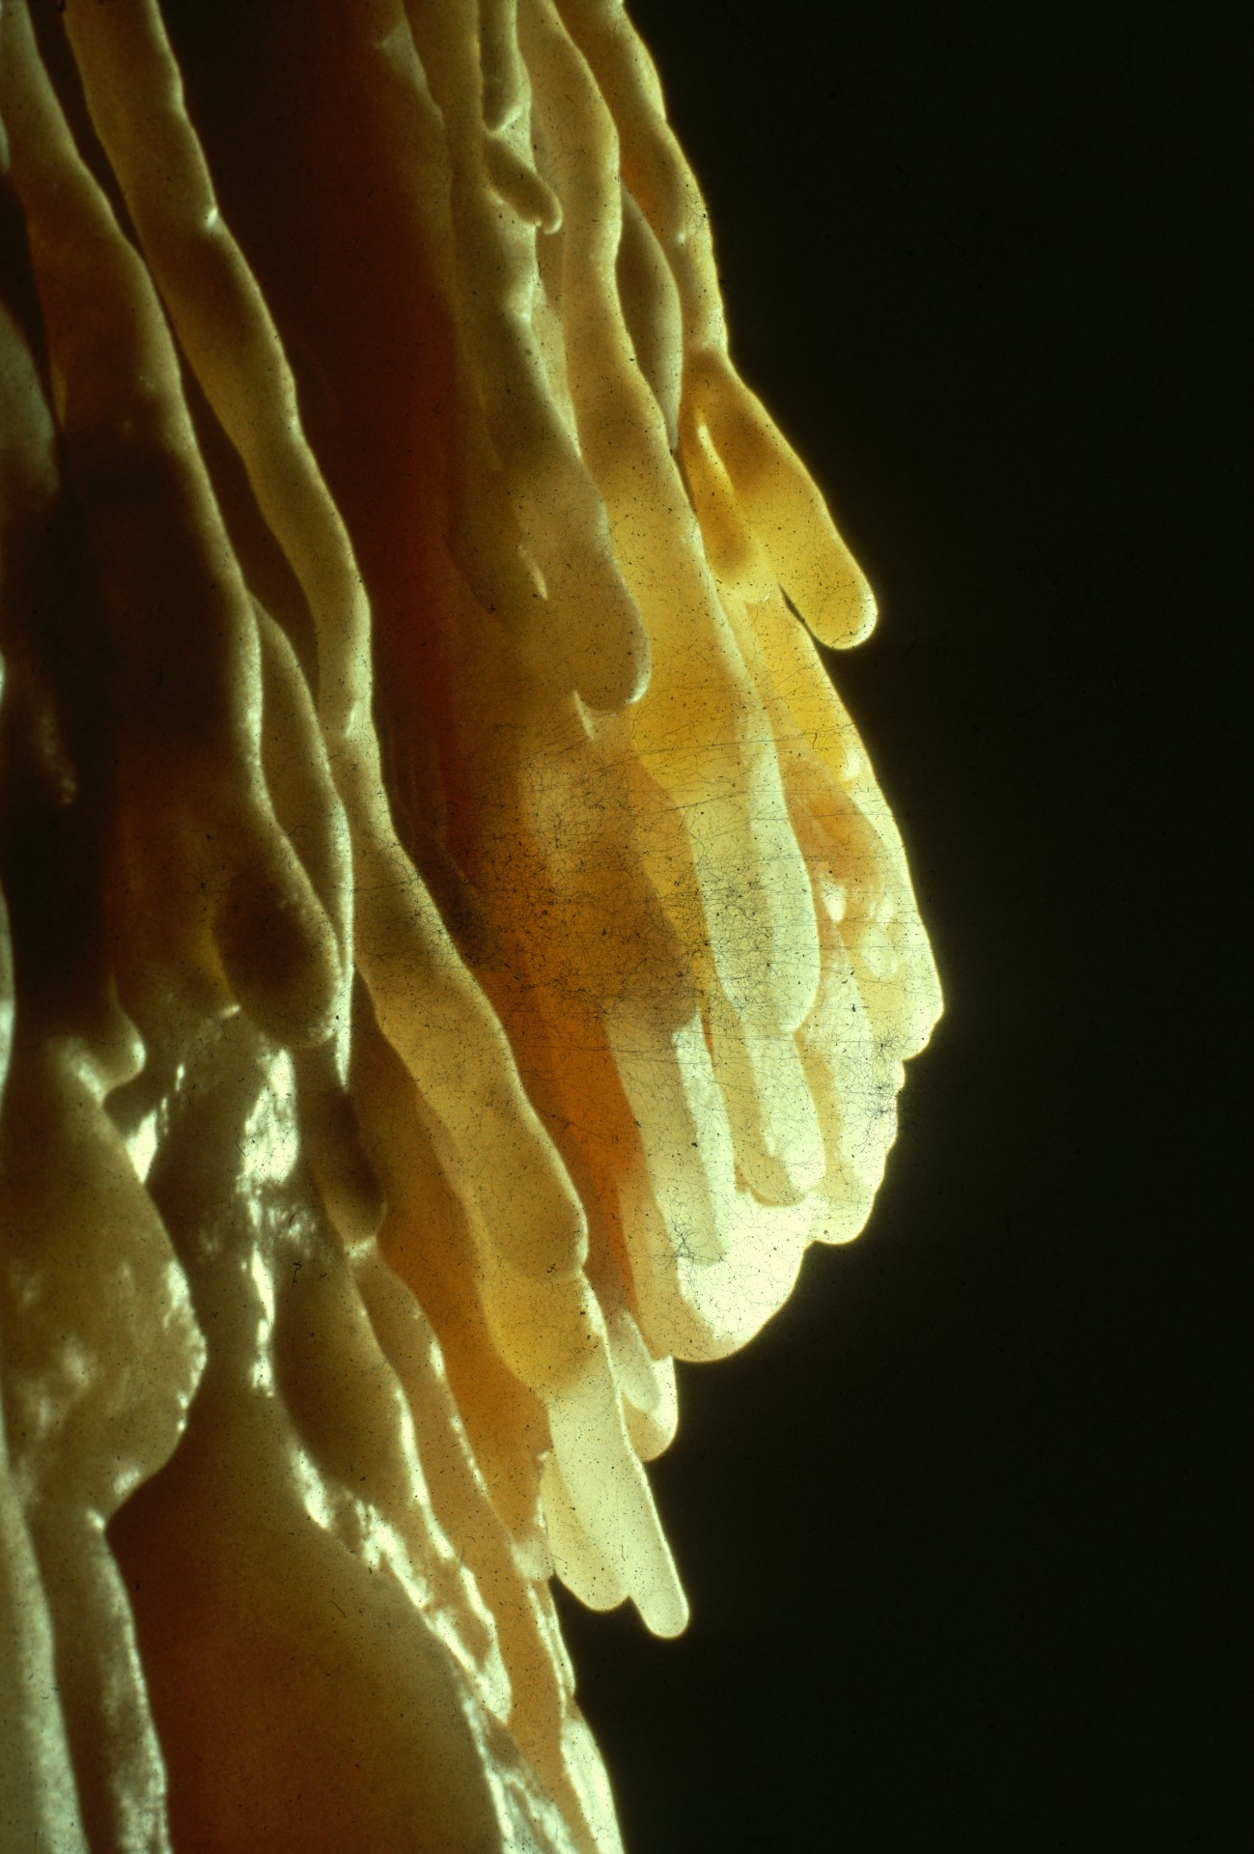
Notes:
CAVE FINGERS – Peter & Ann Bosted

Slide 45
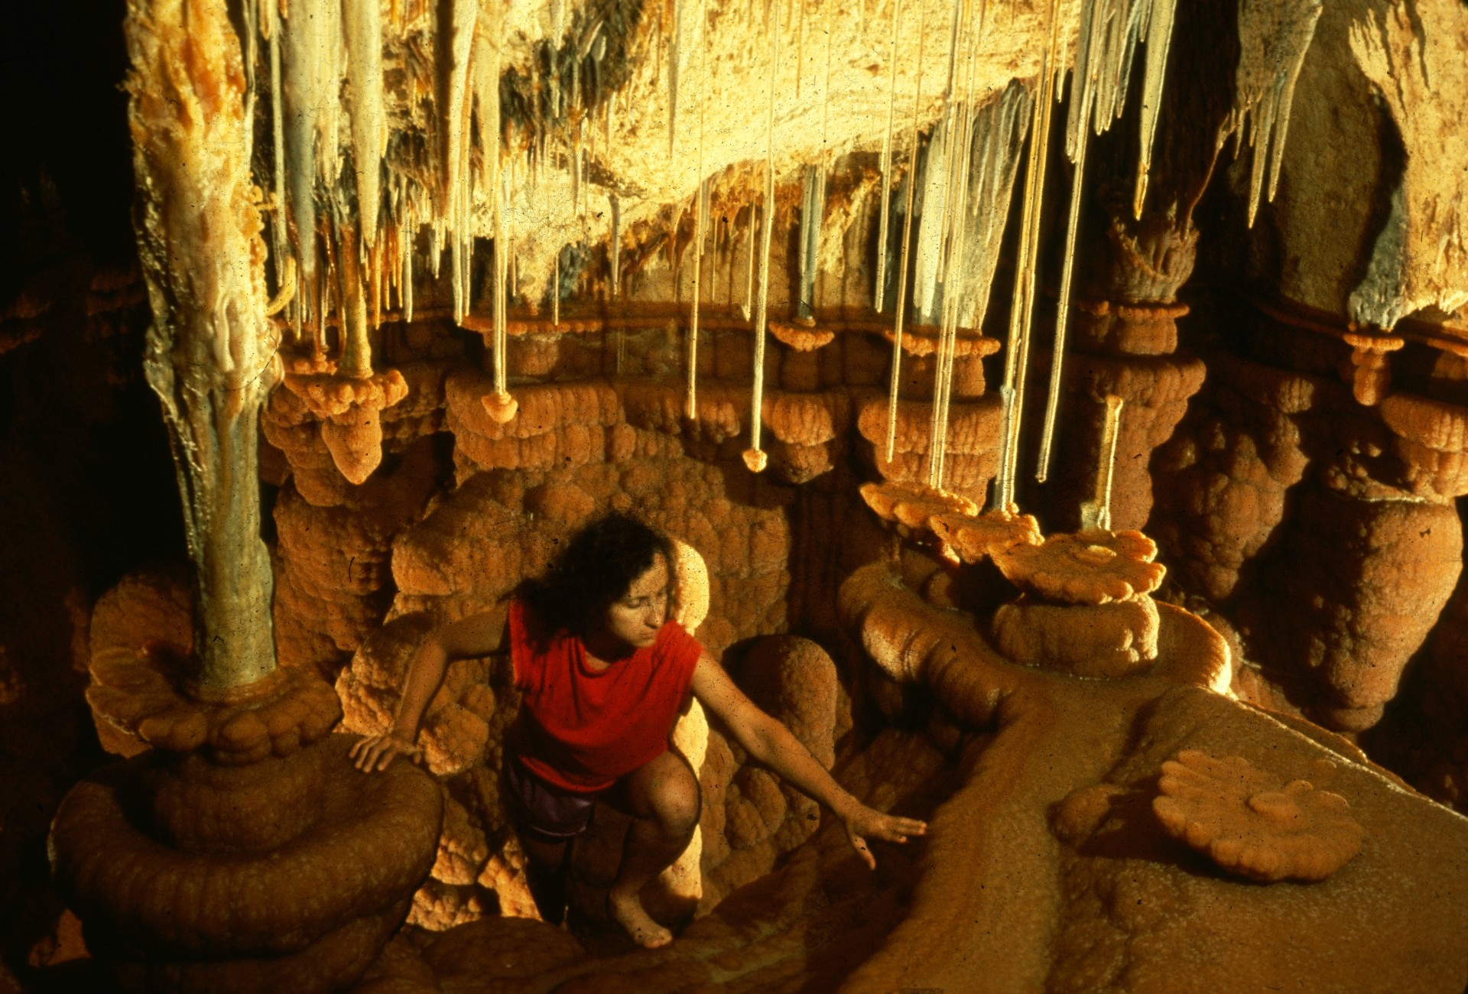
Notes:
CLIMBING INTO THE OASIS – Carol Vesely

Slide 46
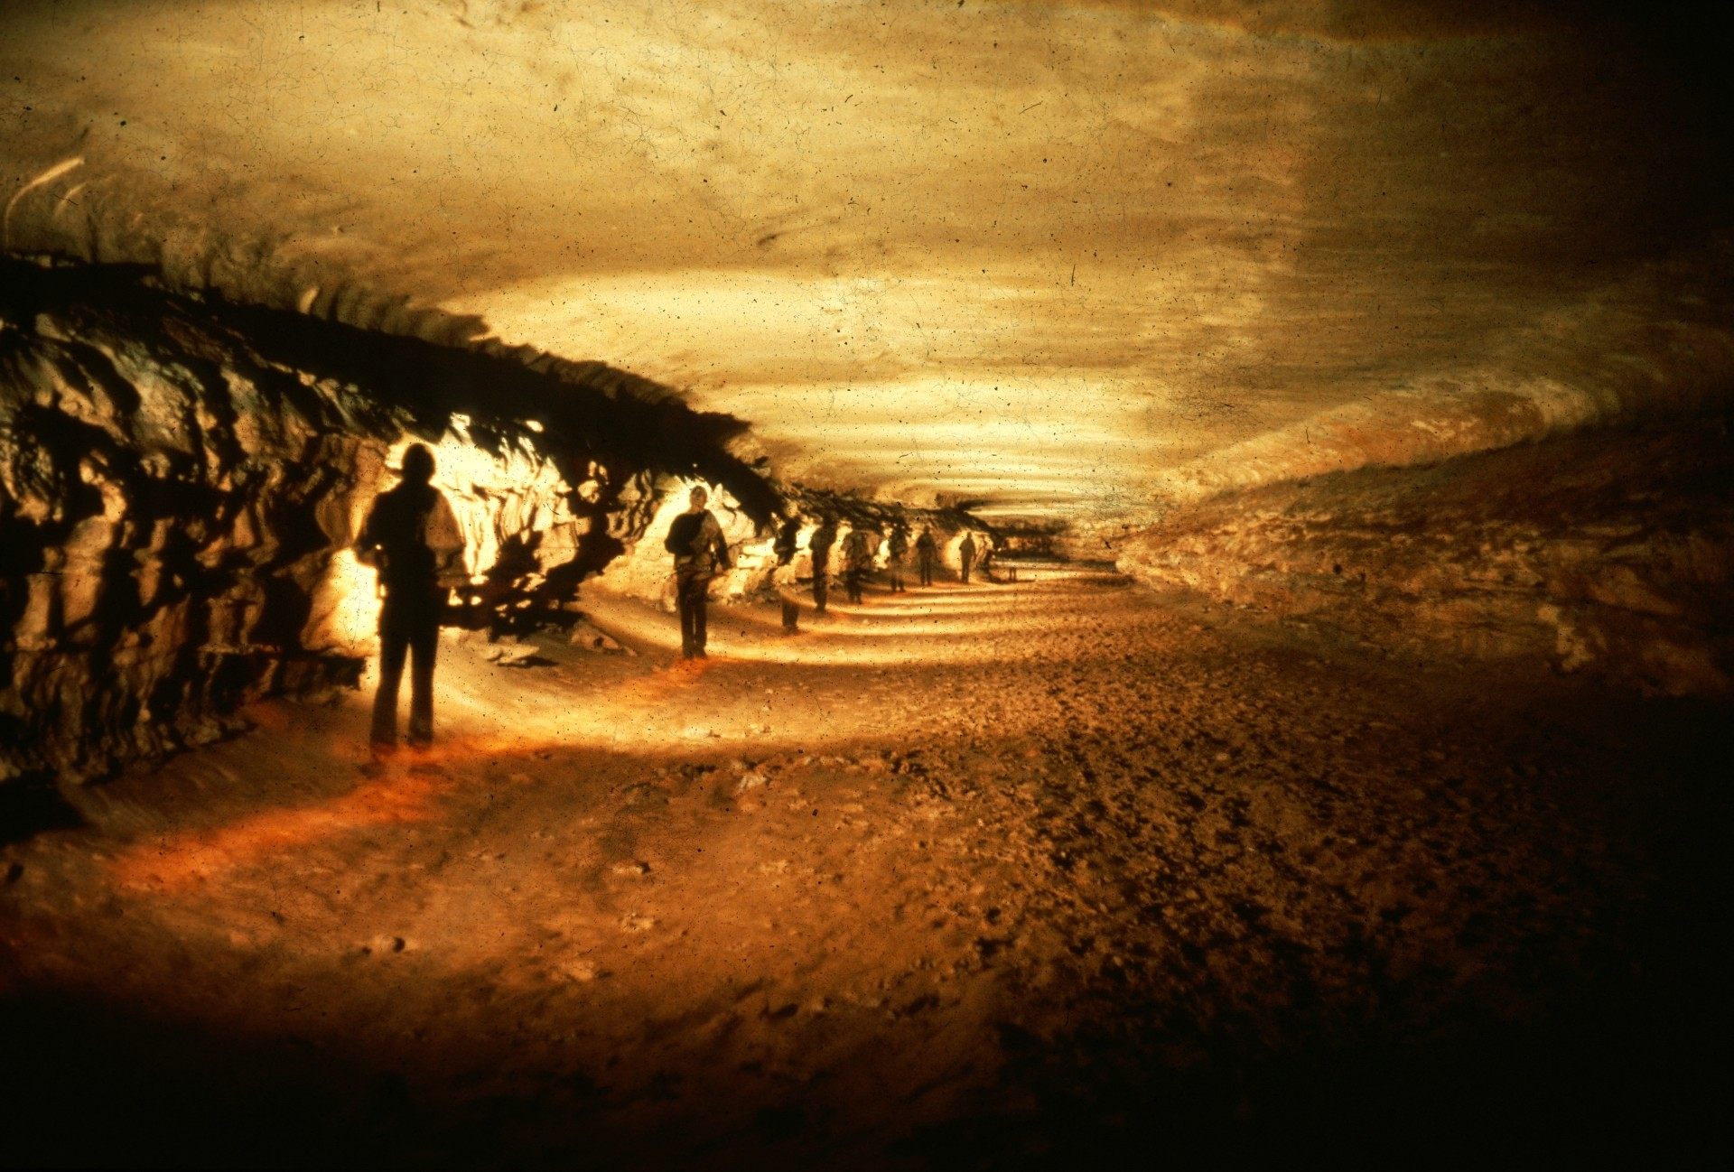
Notes:
INVITING – Ernie Payne

Slide 47
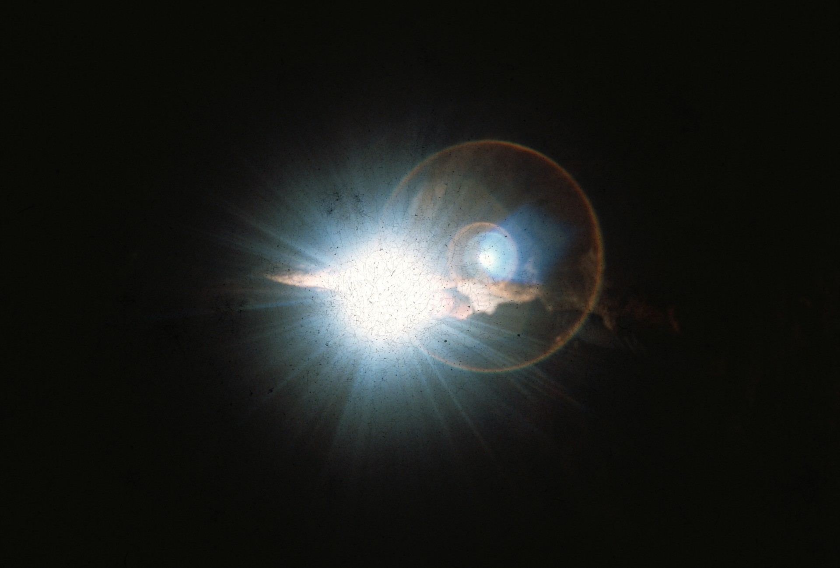
Notes:
TWIGHLIGHT ZONE – Patrick Newby

Slide 48
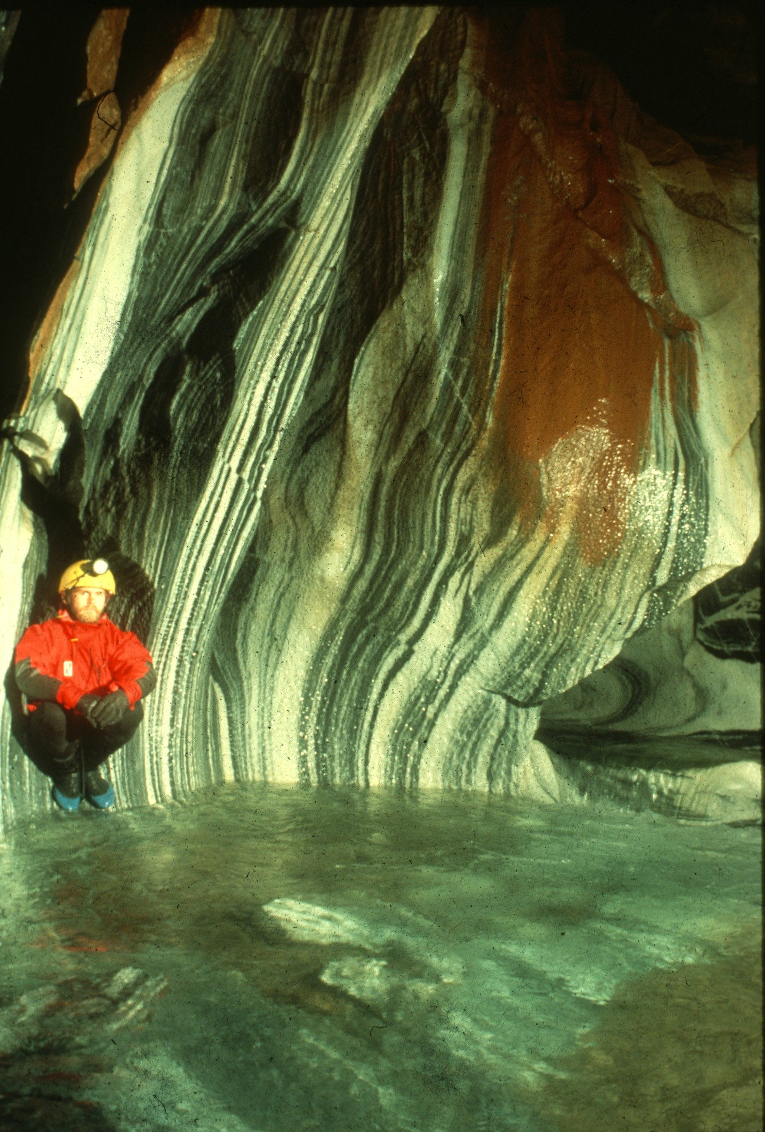
Notes:
CONTRASTS – Dave Bunnell

Slide 49
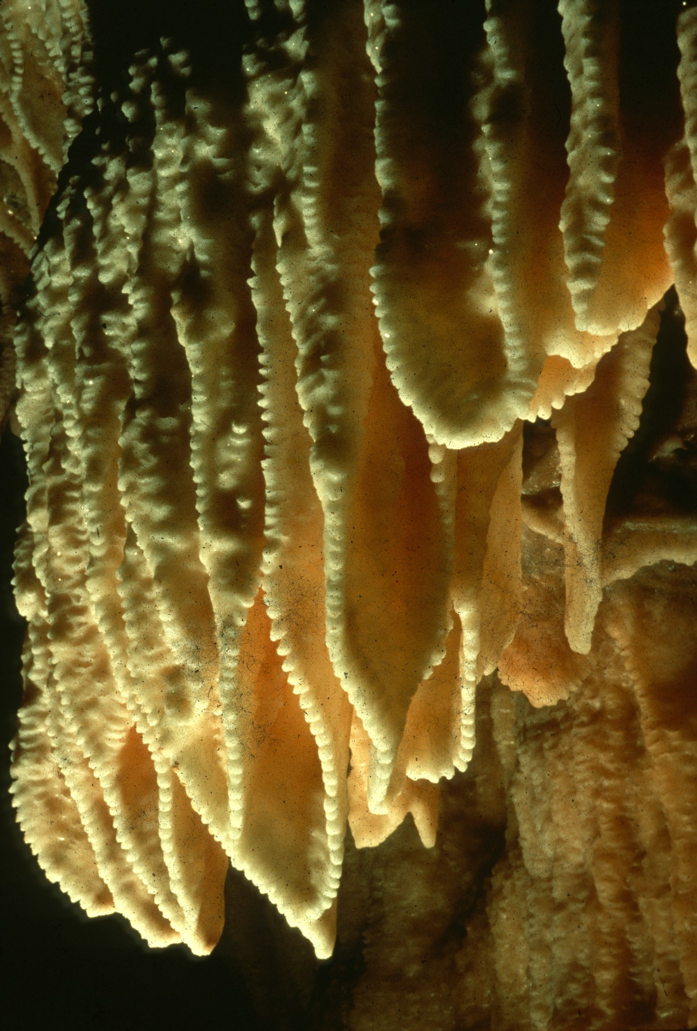
Notes:
DRAMATIC DRAPES – Rick Day

Slide 50
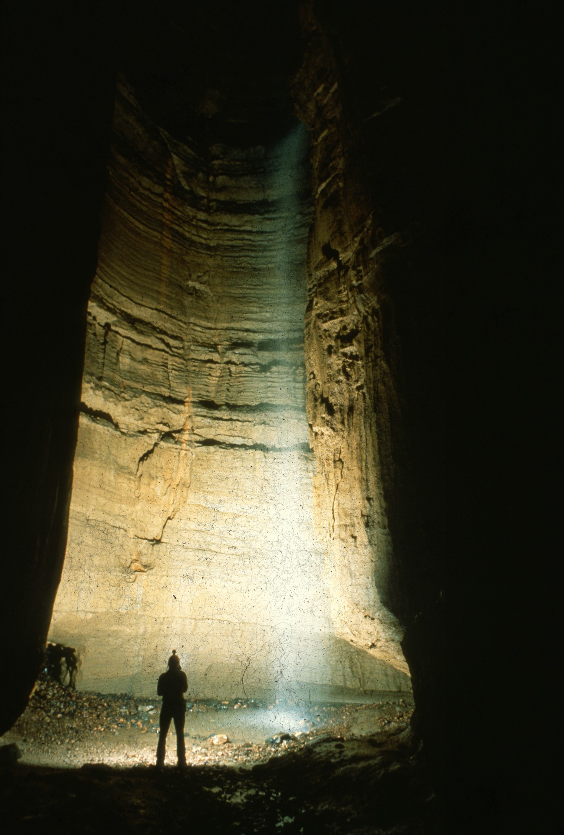
Notes:
THE DEVIL’S SHOWER – Jeff & Alexis Harris

Slide 51
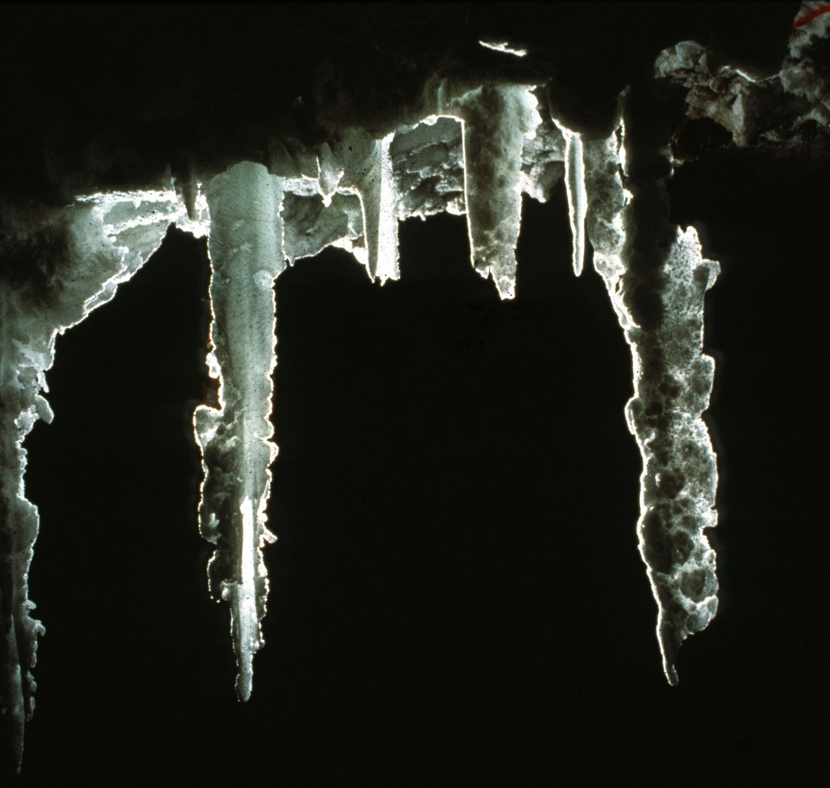
Notes:
LOS TRES AMIGOS – Ralph Earlandson

Slide 52
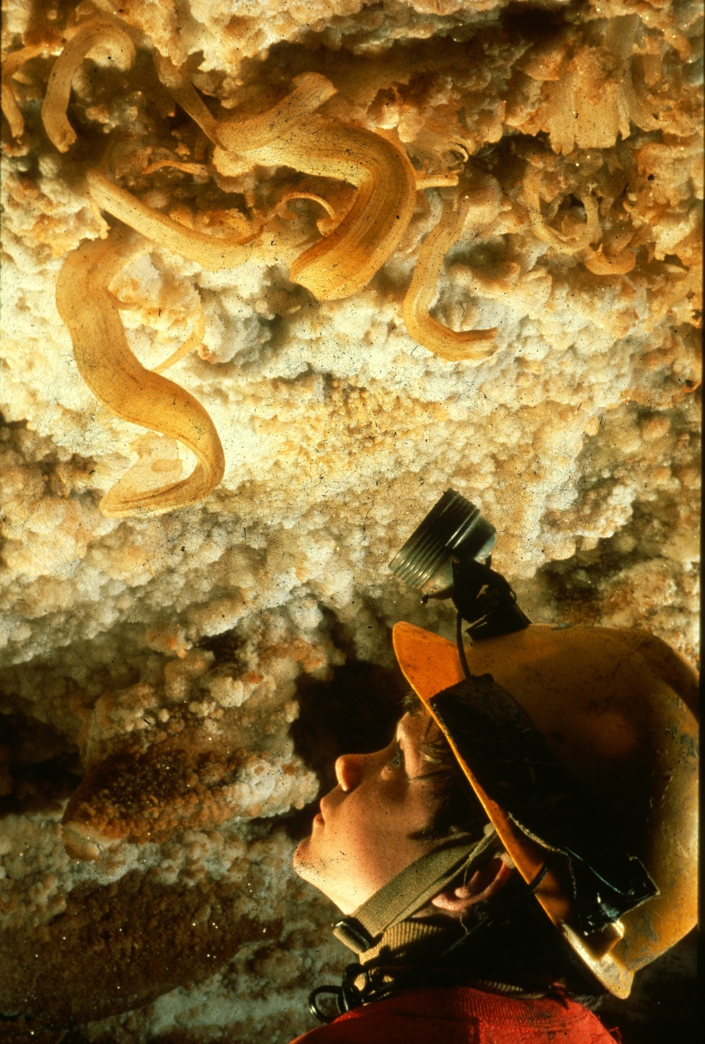
Notes:
A BOY’S BOUQUET – Rick Day

Slide 53

Notes:
BORDER STOP – Michael Goar

Slide 54

Notes:
GOLDEN PONDS – Dave Bunnell

Slide 55

Notes:
DRAPES AND DRIPS – Peter & Ann Bosted

Slide 56

Notes:
CHANDELIERS – Dave Bunnell

Slide 57

Notes:
SURROUNDED BY WHITE – Carol Vesely

Slide 58

MERIT AWARD
PHOTO SALON

Slide 59

Notes:
CANYON CLIMBIN’ – Scott Fee

Slide 60

Notes:
ARAGONITE IN HOLEY SHEEP – Robert Montgomery

Slide 61

Notes:
RAZORBACK BACON – Rick Day

Slide 62

Notes:
FOLIA TEXTURES – Carol Vesely

Slide 63

Notes:
CAVE GODDESS – John Van Swearingen IV

Slide 64

Notes:
WATER MAKES AND WATER BREAKS – Peter & Ann Bosted

Slide 65
BEST OF SHOW
PHOTO SALON

Slide 66

Notes:
ELEGANT SIMPLICITY – Peter & Ann Bosted

Slide 67
Photographers

Slide 68
Photographers:
  Peter and Ann Bosted
  Dave Bunnell
  Rick Day
  Ralph Earlandson
  Dorothy Eckert
  Scott Fee
  Bill Franz
  Mike Goar
  Andy Grubbs

Slide 69
Photographers:
  Maureen Handler
  Jeff and Alexis Harris
  James Loftin
  Robert Montgomery
  Patrick Newby
  Ernest Payne
  John Van Swearingen IV
  Carol Vesely

Slide 70

An NSS Audio-Visual Library Presentation
The Best of the 1989
NSS Photo Salon
Original slide program S910
Slides digitized by David Caudle
PowerPoint program created by Jim McConkey
70 slides, with script in presenter notes
PowerPoint created 2/19/2021
National Speleological Society
6001 Pulaski Pike
Huntsville, AL 35810-1122
256- 852-1300
nss@caves.org
https://caves.org/

